Slide 1


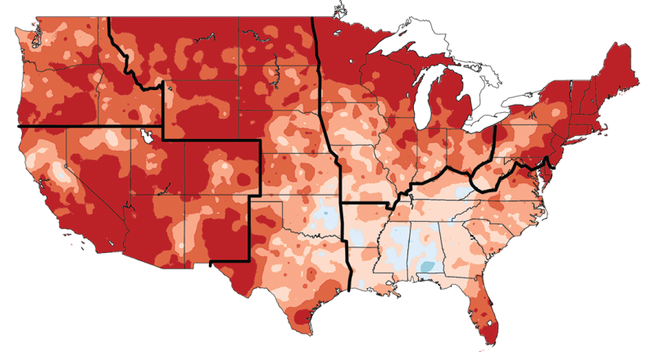
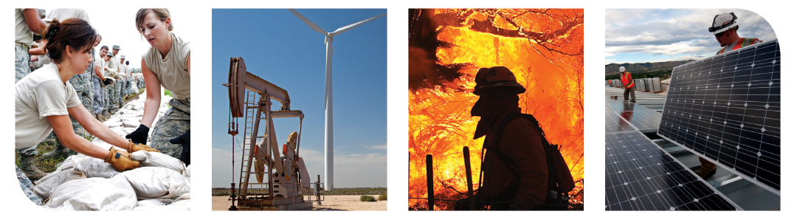

Climate Change Impacts in the United States
Third National Climate Assessment
Emily Therese Cloyd
May 15, 2014

Slide 2

US Global Change Research Program
Global Change Research Act (1990):
“To provide for development and coordination of a comprehensive and integrated United States research program which will assist the Nation and the world to understand, assess, predict, and respond to human-induced and natural processes of global change.”
13 Federal Departments & Agencies + Executive Office of the President
More information:
http://www.globalchange.gov
Notes:
The Global Change Research Act, passed in 1990, established the US Global Change Research Program to coordinate global change research across the federal government

Slide 3
National Climate Assessment:
GCRA (1990), Section 106
…not less frequently than every 4 years, the Council… shall prepare… an assessment which –
integrates, evaluates, and interprets the findings of the Program (USGCRP) and discusses the scientific uncertainties associated with such findings;
analyzes the effects of global change on the natural environment, agriculture, energy production and use, land and water resources, transportation, human health and welfare, human social systems, and biological diversity; and
analyzes current trends in global change, both human- induced and natural, and projects major trends for the subsequent 25 to 100 years.
Notes:
The National Climate Assessment is one of the requirements of the Global Change Research Act. Section 106 of the act requires an assessment every four years that:
synthesizes the science of global change
discusses the impacts of global change in a number of socioeconomic sectors
and analyzes trends in global change for the next 25 to 100 years

Slide 4
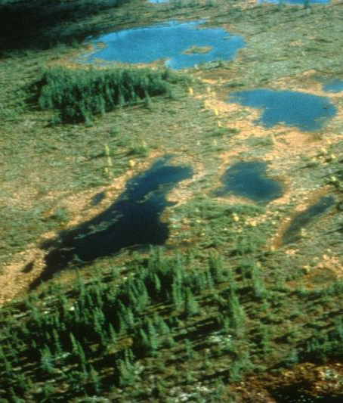
The Third National Climate Assessment
Goal
Enhance the ability of the United States to anticipate, mitigate, and adapt to changes in the global environment.
Vision
Advance an inclusive, broad-based, and sustained process for assessing and communicating scientific knowledge of the impacts, risks, and vulnerabilities associated with a changing global climate in support of decision-making across the United States.
Notes:
With this next round of assessment, we will maintain a focus on synthesizing the best-available science while also looking to provide that science to users in such a way that it can support decisions about how we prepare for and respond to climate change.
In order to achieve this, we have set our sights on creating a process that reaches beyond the federal government to include state, local, and tribal governments, the business community, academic institutions, non-profit organizations, and many others that contribute to and use assessments.

Slide 5
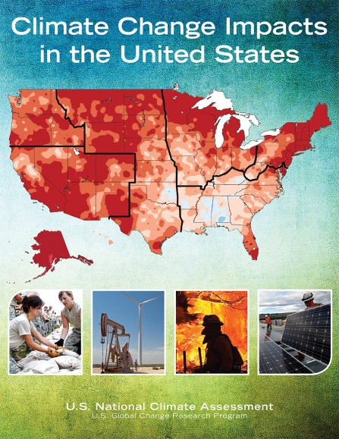
Outline for Third NCA Report
Climate Change and the American People
Overview and Report Findings
Our Changing Climate
Sectors & Sectoral Cross-cuts
Regions & Biogeographical Cross-cuts
Responses
Appendices
Read online or download at:
http://nca2014.globalchange.gov
Notes:
Outline for the Third NCA Report – chapters on climate science, sectors and sectoral cross-cuts, regions, society’s responses – new for this report, future research needed, and the long-term assessment process

Slide 6
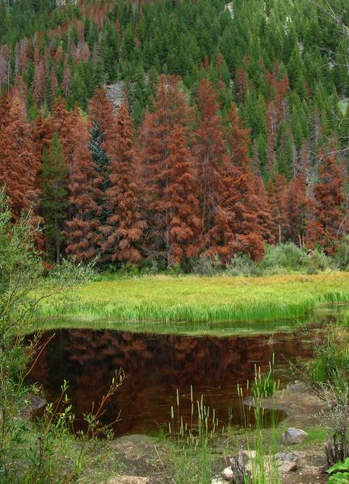
Sectors
Water Resources
Energy Supply and Use
Transportation
Agriculture
Forests
Ecosystems and Biodiversity
Human Health
Notes:
The sectors – most of which are required by the Global Change Research Act

Slide 7

Sectoral Cross-Cuts
Energy, Water, and Land Use
Urban Systems and Infrastructure
Indigenous Peoples, Lands, and Resources
Land Use and Land Cover Change
Rural Communities
Biogeochemical Cycles
Notes:
New for this report are chapters focusing on a number of cross-cutting issues

Slide 8
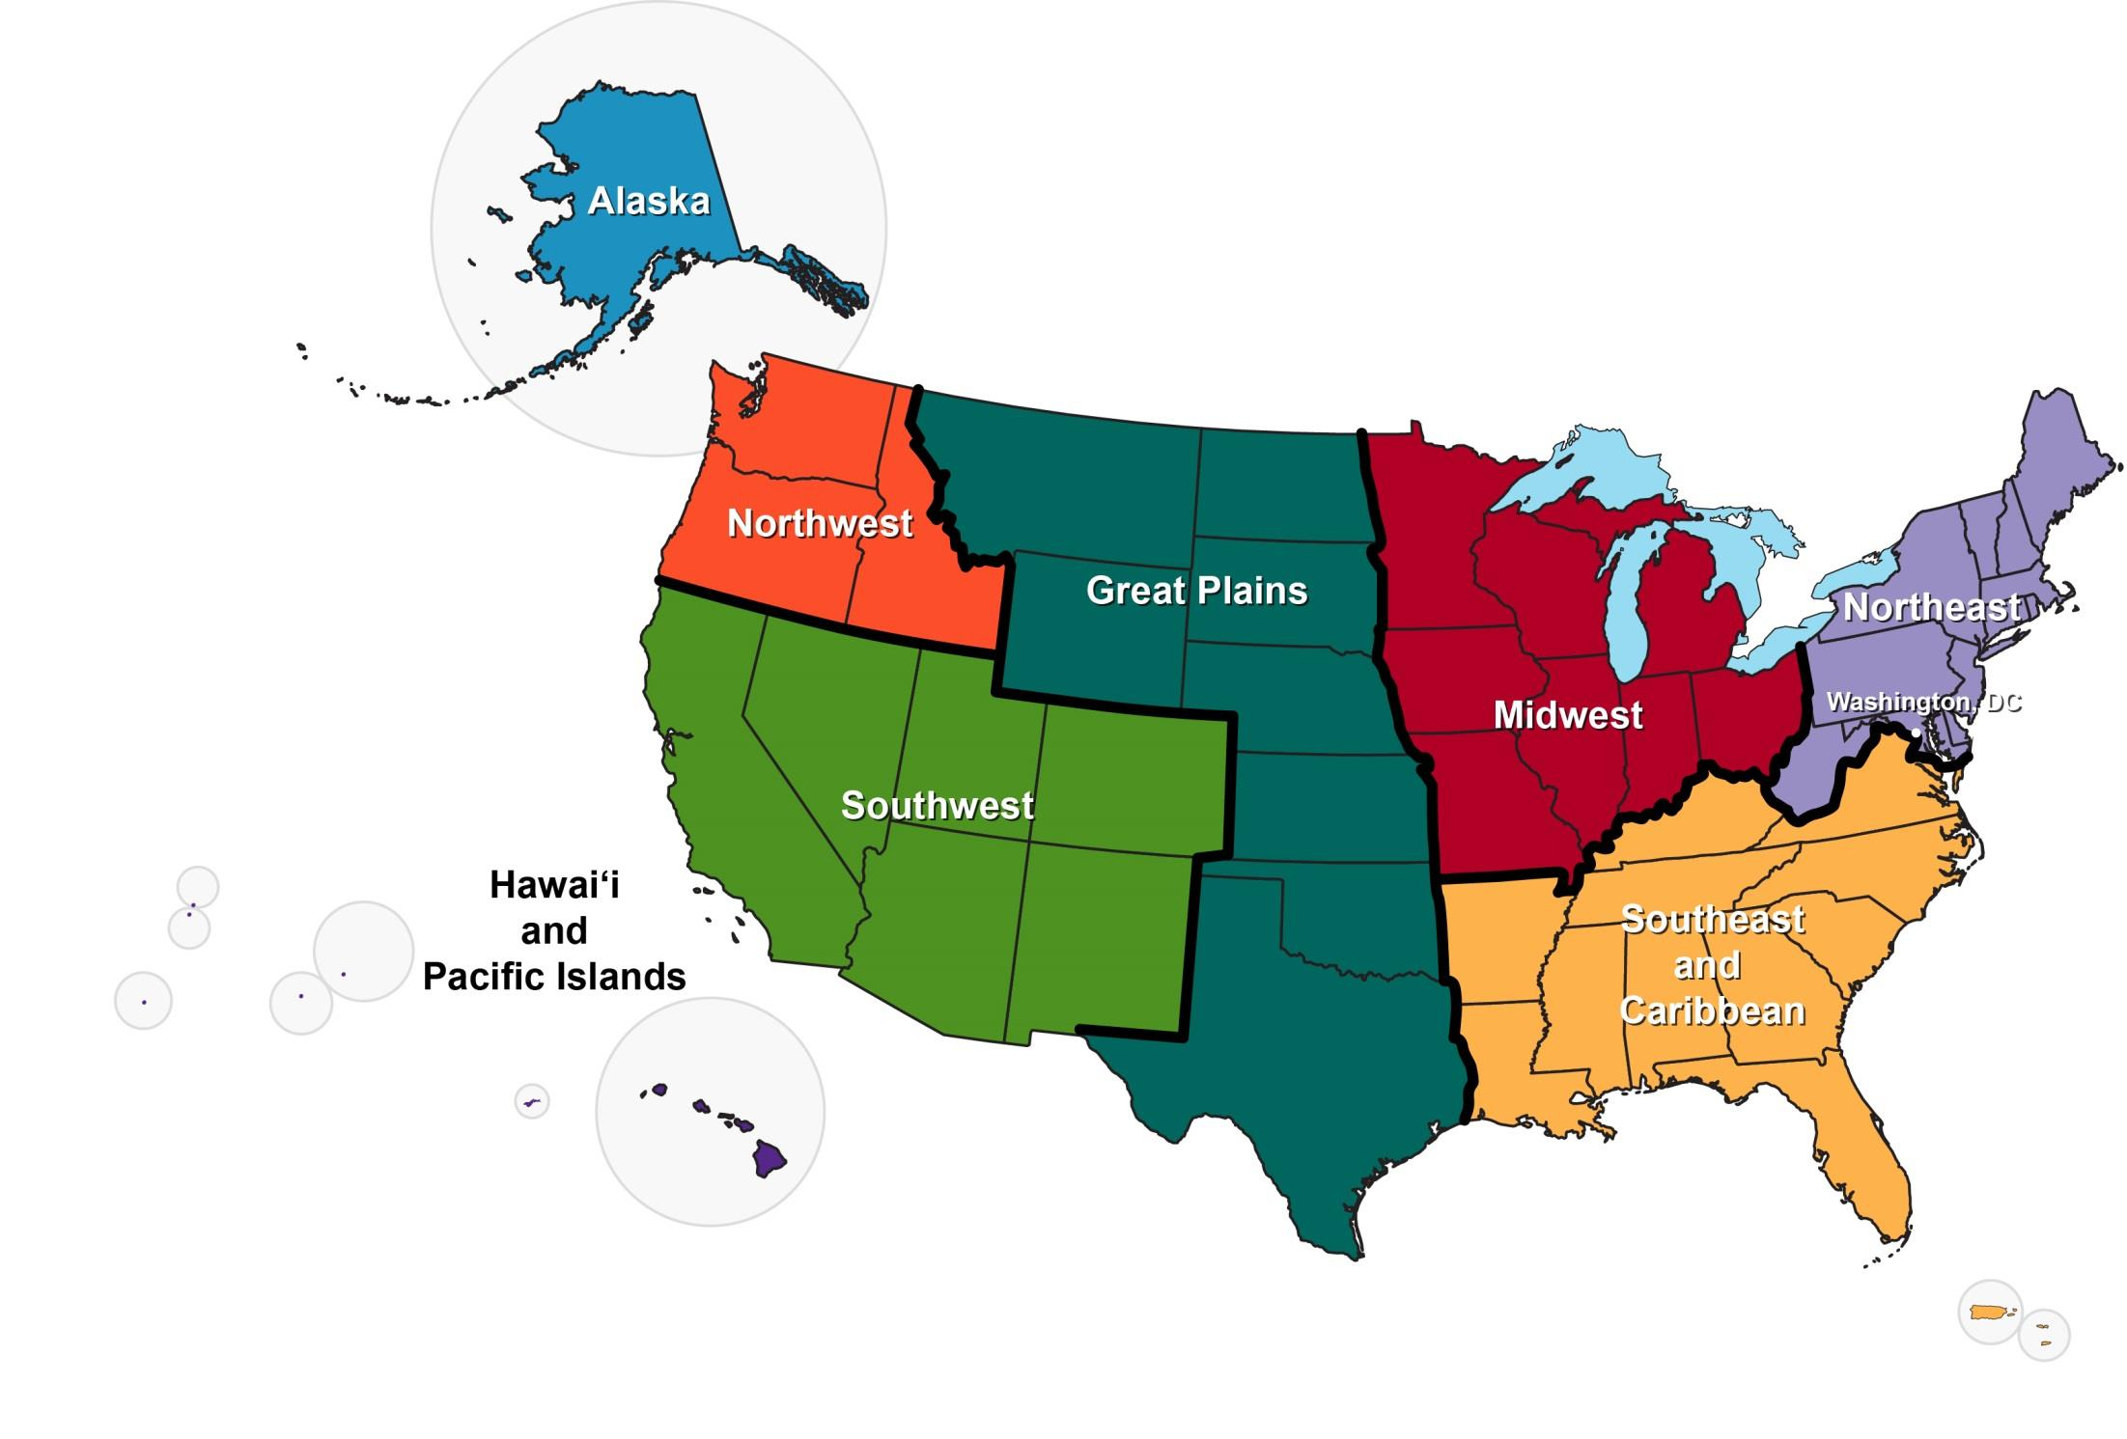
Regions & Biogeographical Cross-Cuts
Oceans and Marine Resources
Coasts
Notes:
There are eight regions – drawn along state boundaries – and chapters on coasts and on oceans

Slide 9

Responses
Decision Support
Mitigation
Adaptation
Research Needs
Sustained Assessment

Slide 10

Appendices
Process
Information Quality
Climate Science Supplement
Frequently Asked Questions
Scenarios and Models
Future Assessment Topics

Slide 11
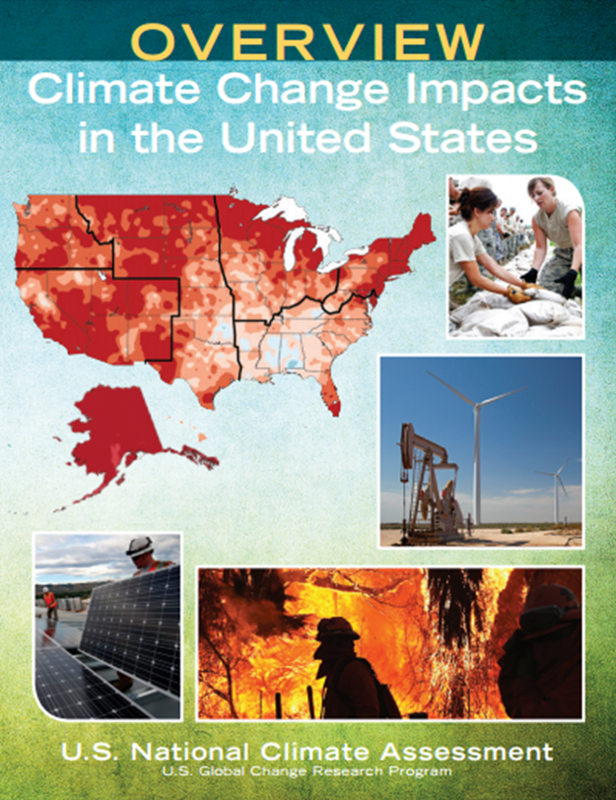
Climate Change and the American People
“Climate change, once considered an issue for a distant future, has moved firmly into the present.”
“…the evidence of human-induced climate change continues to strengthen and impacts are increasing across the country.”
“…there is still time to act to limit the amount of change and the extent of damaging impacts.”

Slide 12
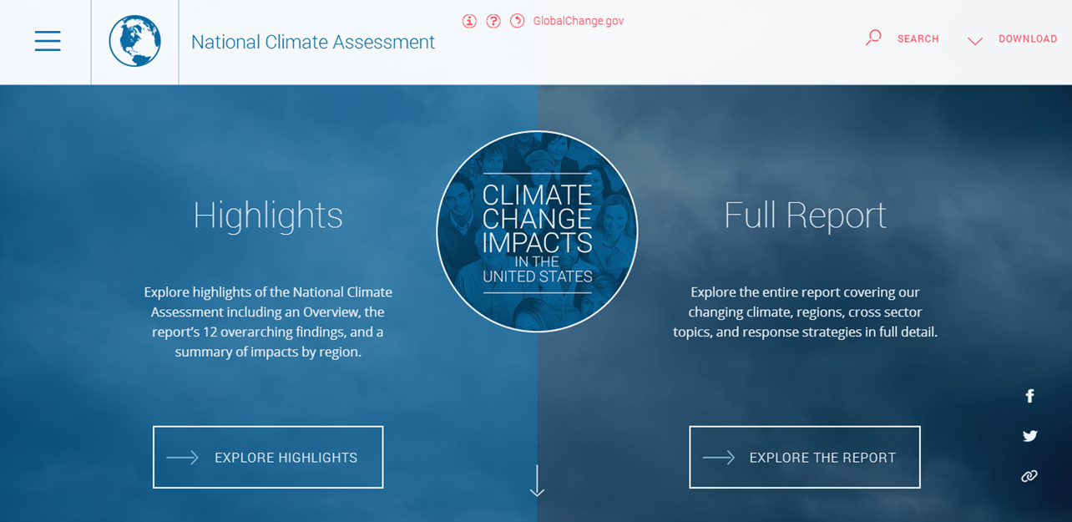
nca2014.globalchange.gov

Slide 13
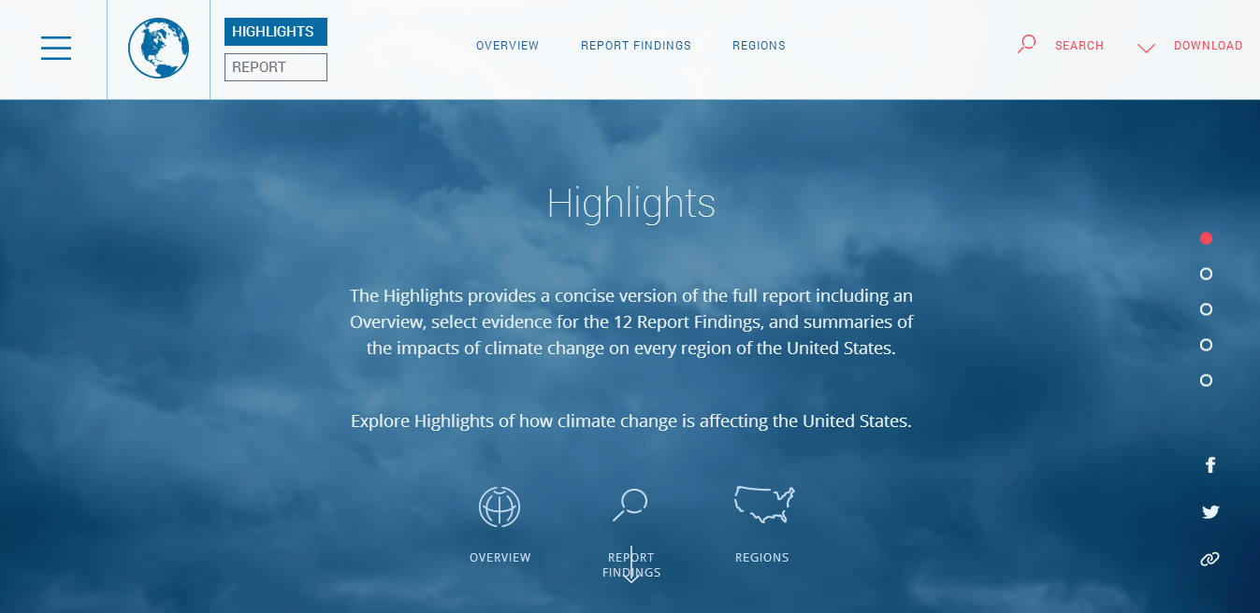
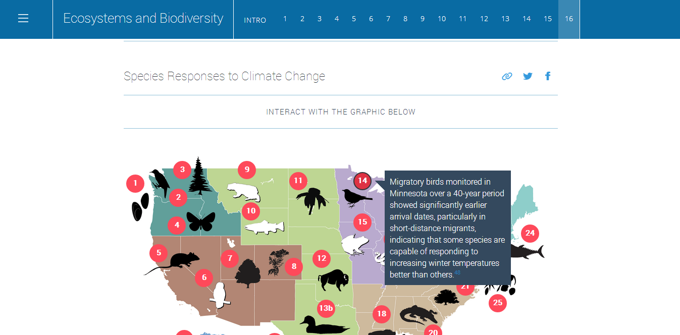
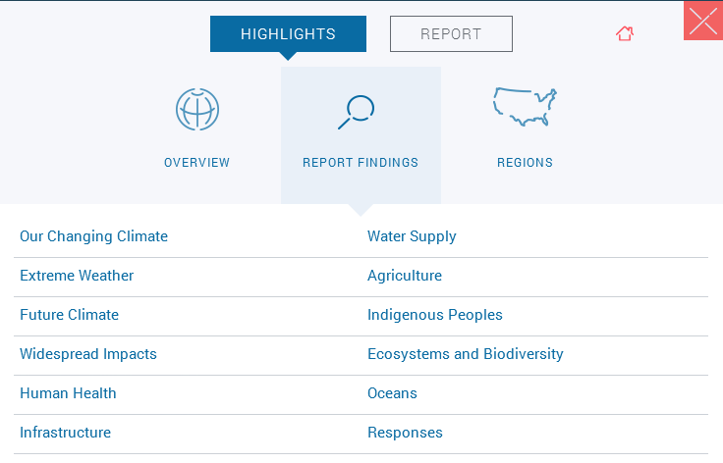
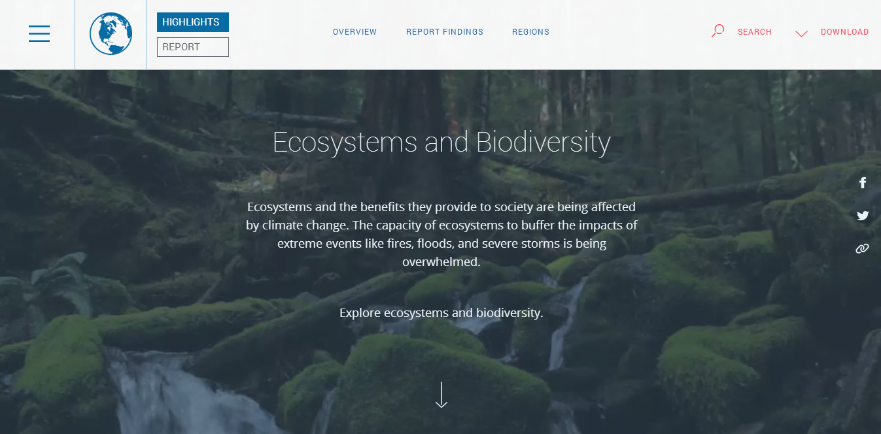
Overview & Highlights nca2014.globalchange.gov/highlights

Slide 14
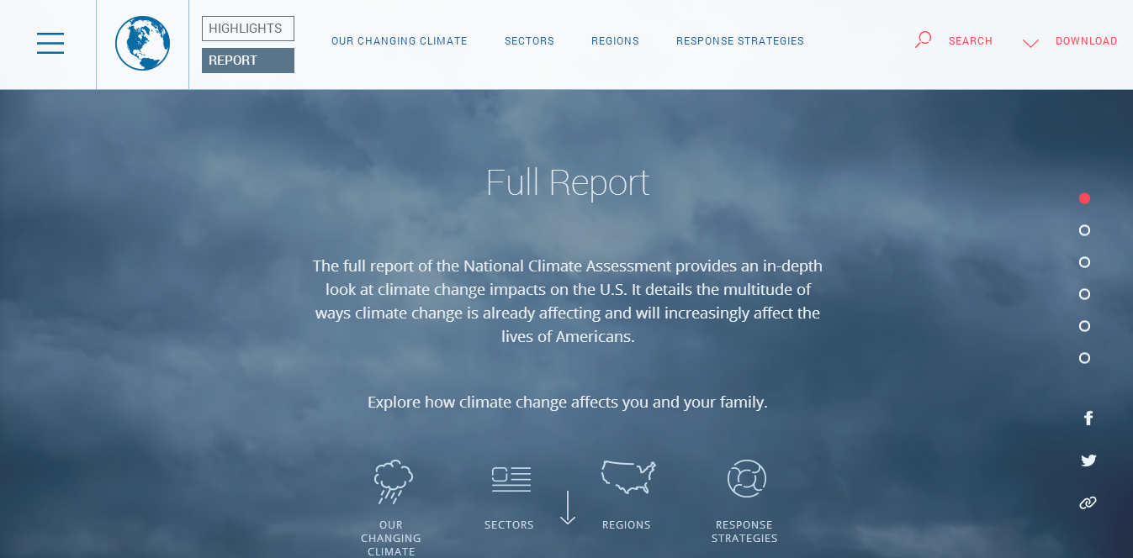
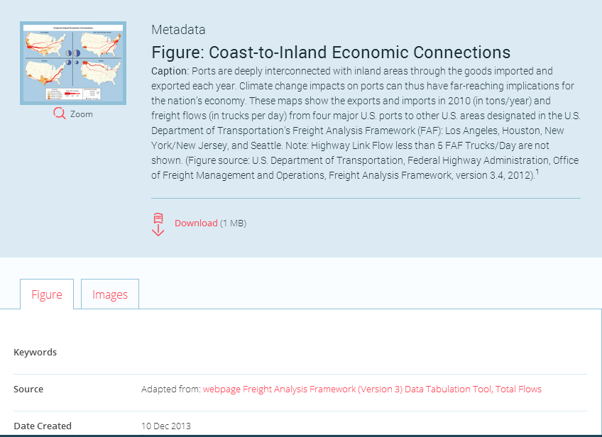
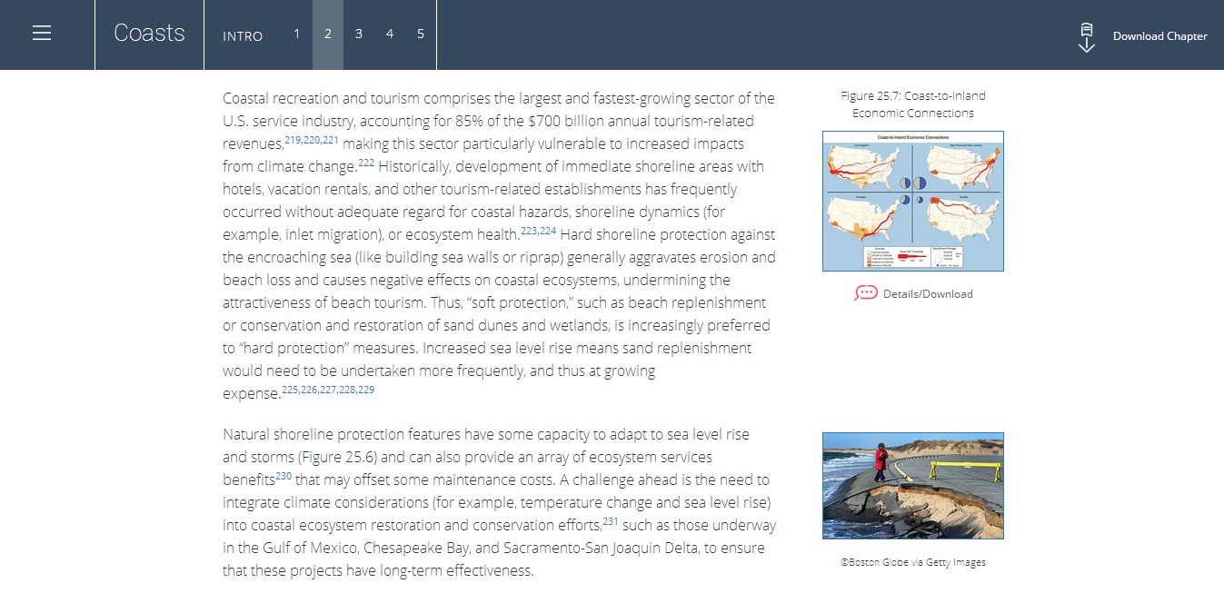
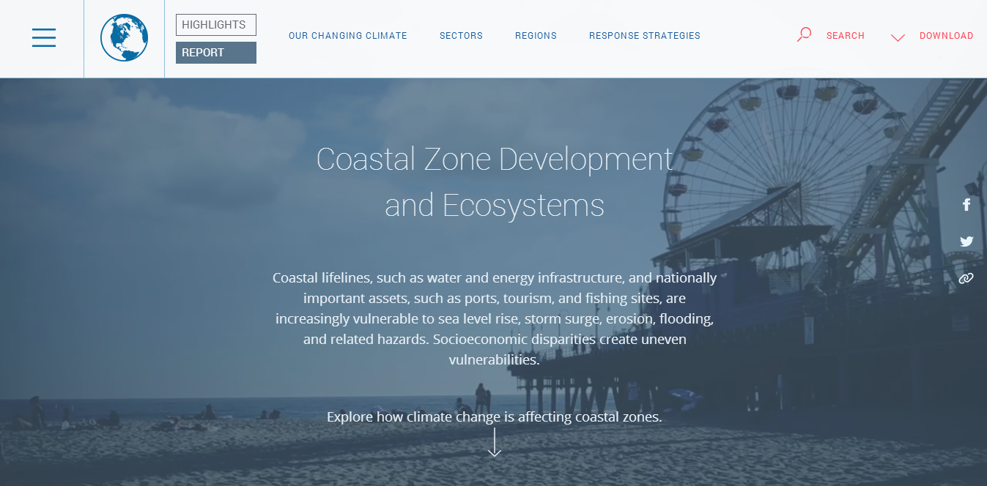
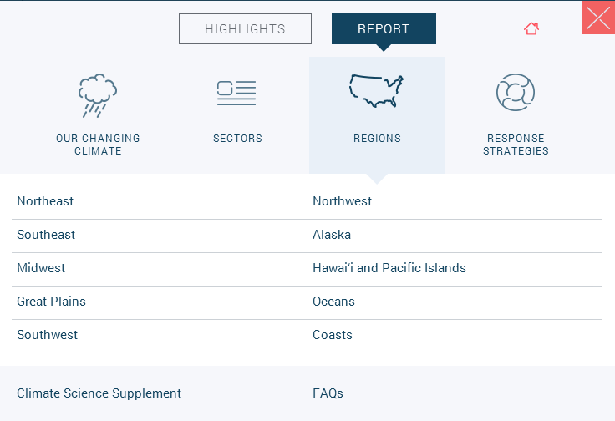
Full Report nca2014.globalchange.gov/report

Slide 15
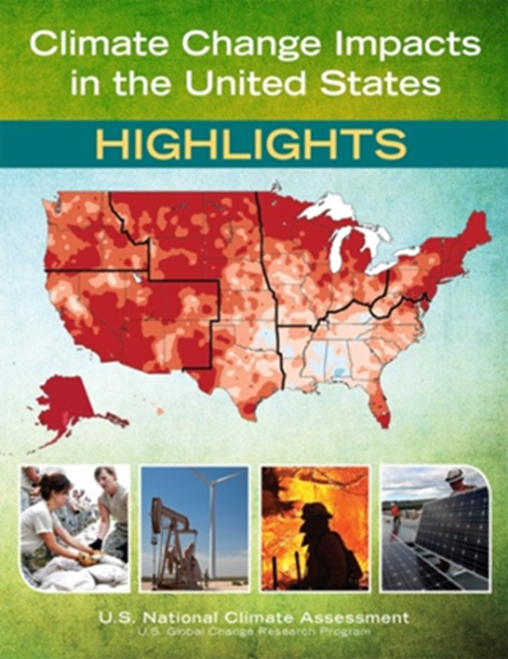
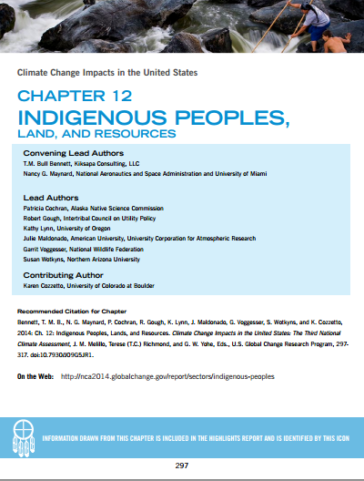
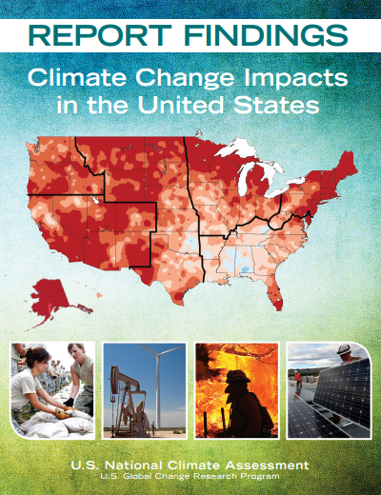
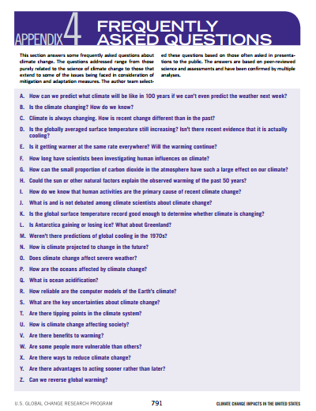
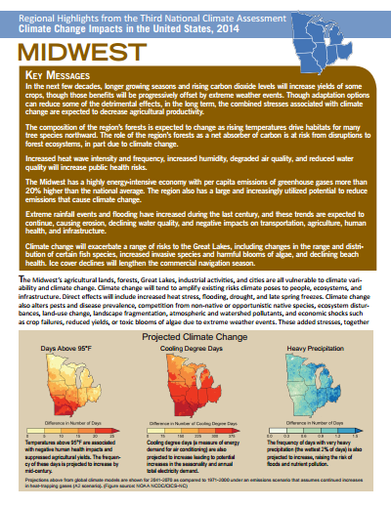
Downloadable Materials www.globalchange.gov/nca3-downloads-materials

Slide 16
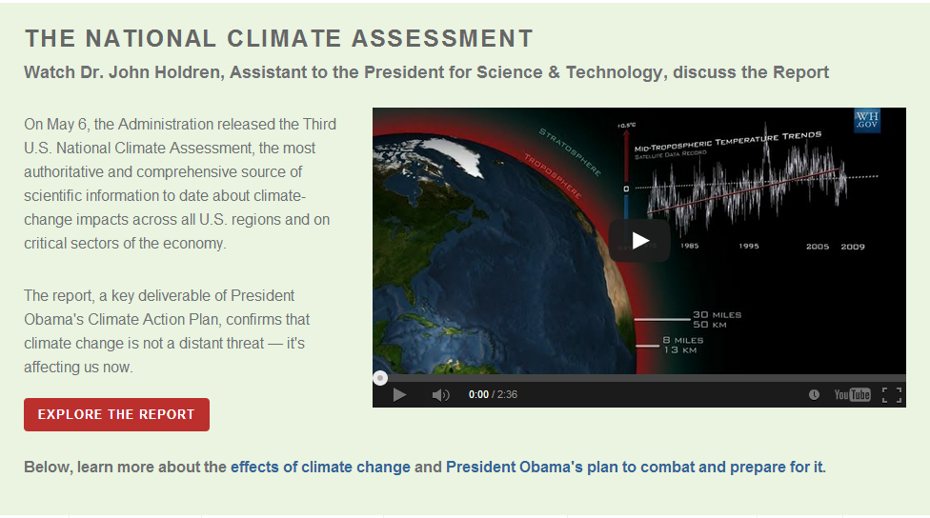
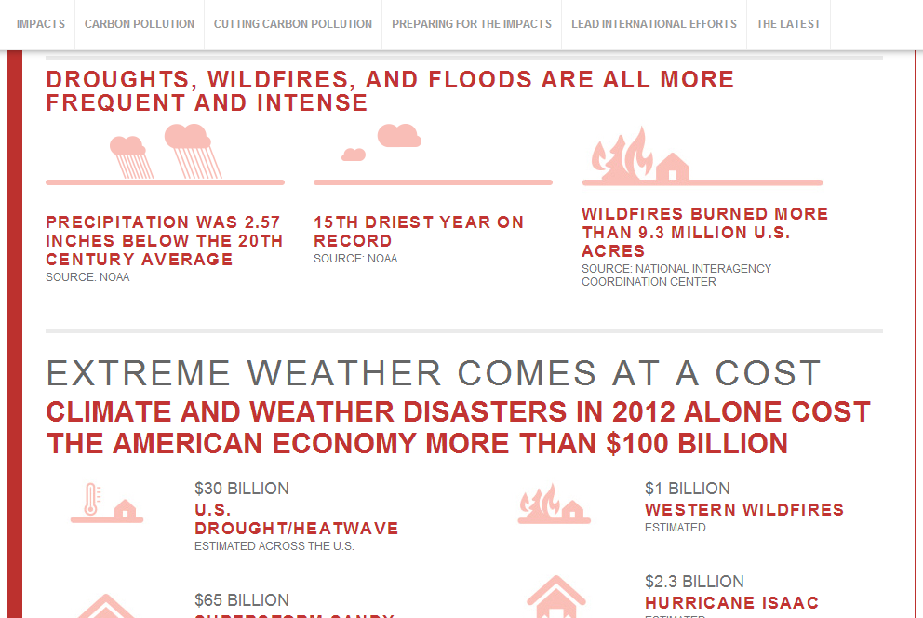
White House Resources www.whitehouse.gov/climate-change

Slide 17
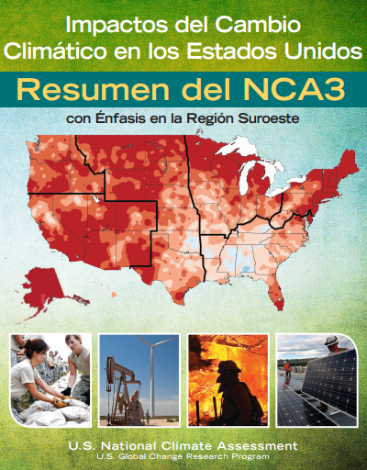
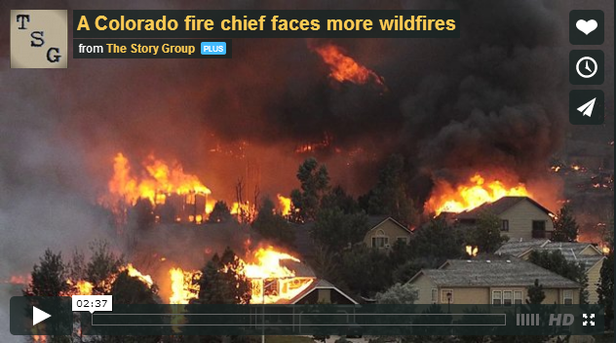
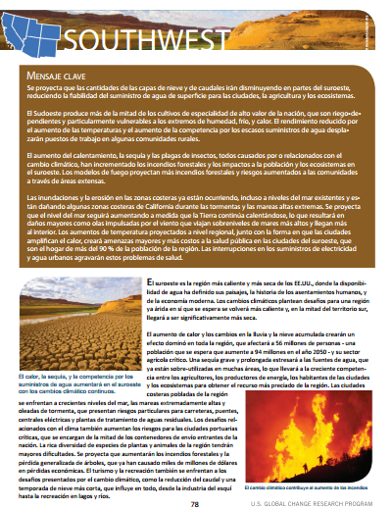
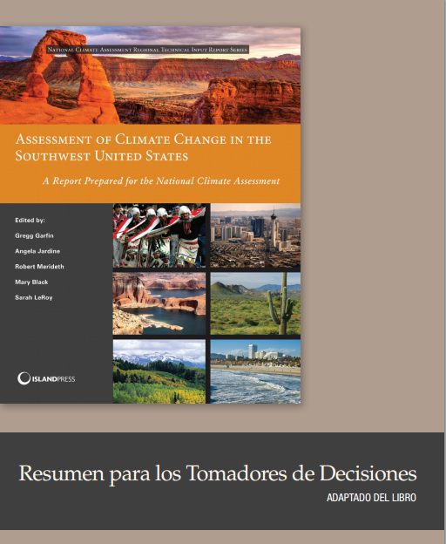
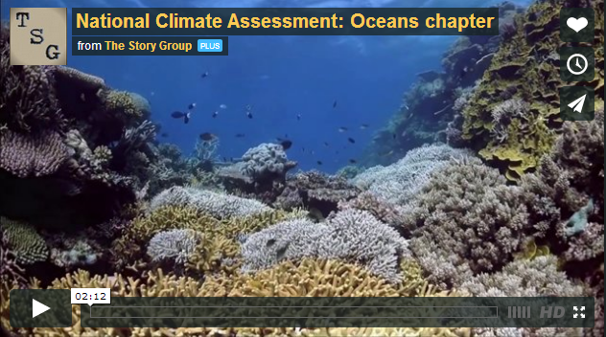
External Resources www.globalchange.gov/engage/external-resources
Spanish language resources:
http://www.ccass.arizona.edu/nca
Videos: Chapters & Americans on the Front Lines
http://vimeo.com/channels/nca

Slide 18
NCAnet: Partners in Assessment
Online at http://ncanet.usgcrp.gov
Host events that leverage NCA
Translate & share NCA with members and stakeholders
Toolkit of materials related to USGCRP and the NCA
130+ partner organizations
Professional societies
Academic institutions and consortia
Non-governmental organizations
Local and state government departments
Private sector
Notes:
Building a sustained assessment process relies on building a network of partners within and outside of the federal government who can help create, maintain, and champion the assessment process. While the USGCRP provides the federal side of this network, it does not have connections to the broader community of assessment users and contributors outside of the government. Thus we have begun to build this network as NCAnet, which includes partners from local, state, and tribal governments; academia; non-governmental organizations; business and industry; professional societies; and other organizations.

Slide 19


Climate Change Impacts in the United States http://nca2014.globalchange.gov
Third National Climate Assessment
#NCA2014
facebook.com/usgcrp
@usgcrp
Emily Therese Cloyd, ecloyd@usgcrp.gov

