Slide 1

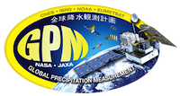


Welcome to the Global Precipitation Mission/ETS Mini-Grants Webinar! with
Dorian Janney (NASA)
Leah Eskelin (USFWS)
Susan Sachs (NPS)
Tim Taglauer (NPS)

Slide 2
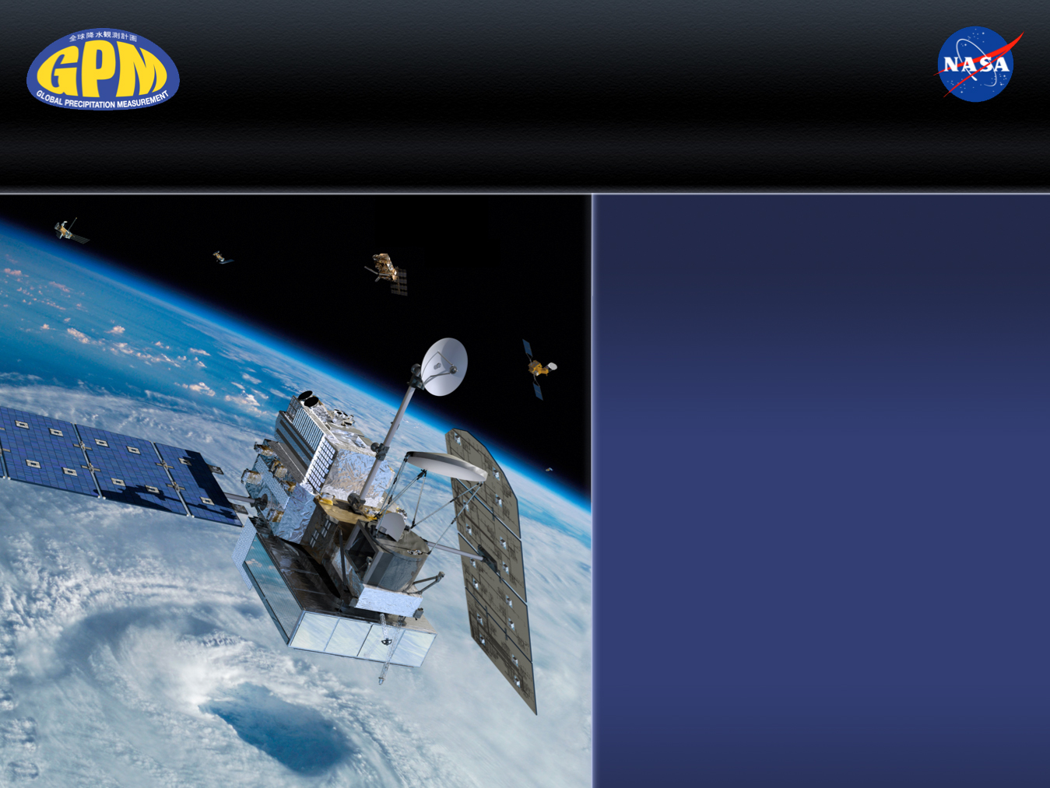
Global Precipitation Measurement (GPM) Mission
Dorian Janney
GPM Education Specialist
Dorian.W.Janney@nasa.gov
ETS-GPM webinar
May 20, 2014

Slide 3


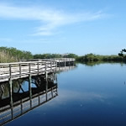
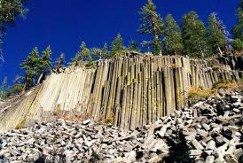
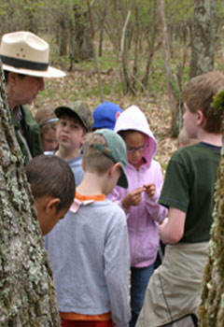
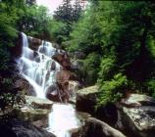
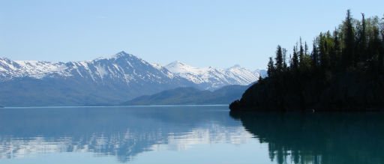
GPM and “Earth to Sky” Team Up with National Park and U.S. Fish and Wildlife Interpreters!
NPS and FWS interpreters will collaborate with GPM E/PO
staff to develop various programs and materials to engage the public
in learning about GPM and its impact on increasing our understanding
of Earth’s water cycle, weather and climate, and various
societal applications.
Everglades National Park will develop an interpretive display that will include NASA and GPM data and information.
At Devil’s Postpile National
Monument, a new program will
engage underserved youth in
field studies to connect snow
depth with freshwater resources.
Shenandoah National Park will develop an educational program to help secondary students see the relationship between precipitation and salamander habitats in an effort to determine if climate change is altering the types of species in the park.
In the Great Smoky Mountains NP, the public will take part in conducting phenology research.
At the Kenai National Wildlife Refuge,
visitors will interact with a weather station
And collect precipitation data in an effort
To increase their understanding about the
Impact of climate change in their region.
3
Dorian Janney
Dorian.w.janney@nasa.gov

Slide 4
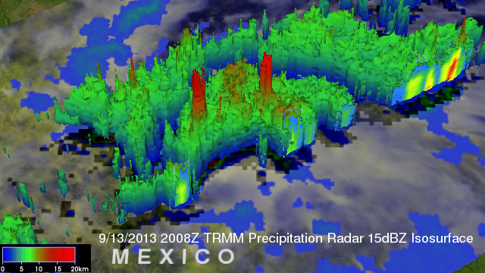
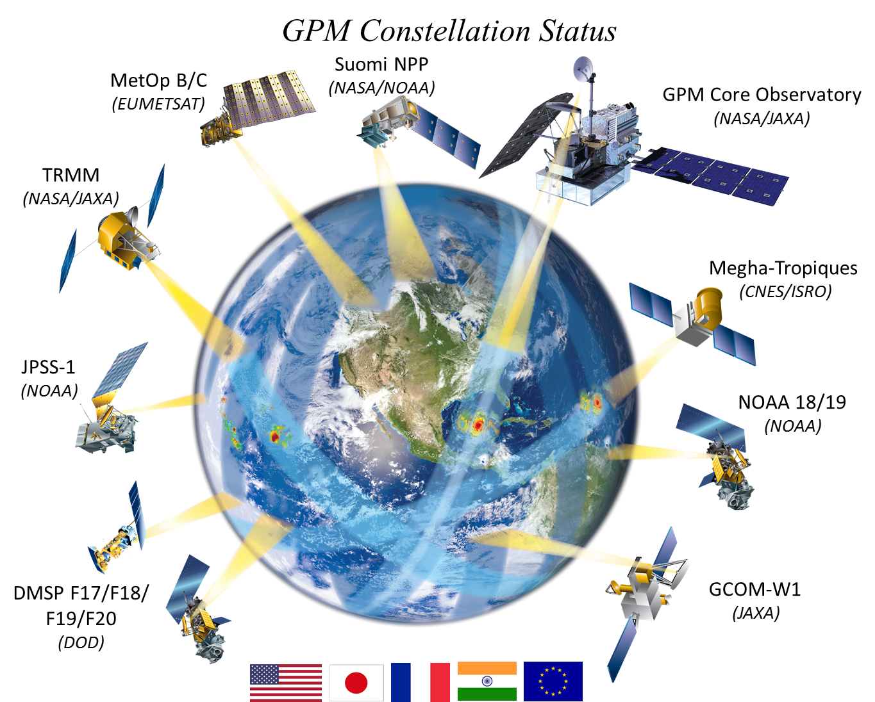
Tropical Rainfall Measuring Mission
TRMM: Tropical Rainfall Measuring Mission
Launched in 1997 to measure tropical rainfall
Currently has an nearly 16-year record of precipitation
Partnership between NASA and the Japan Aerospace Exploration Agency (JAXA)
Tropical Storm Ingrid on Friday, Sept. 13th
TRMM Precipitation Radar recorded “hot towers” (red) that often signal a tropical cyclone will intensify
GPM: Global Precipitation Measurement
GPM builds upon TRMM’s concept and will look at precipitation with greater accuracy around the world
GPM will use inputs from an international constellation of satellites to provide improved space and time coverage of precipitation

Slide 5
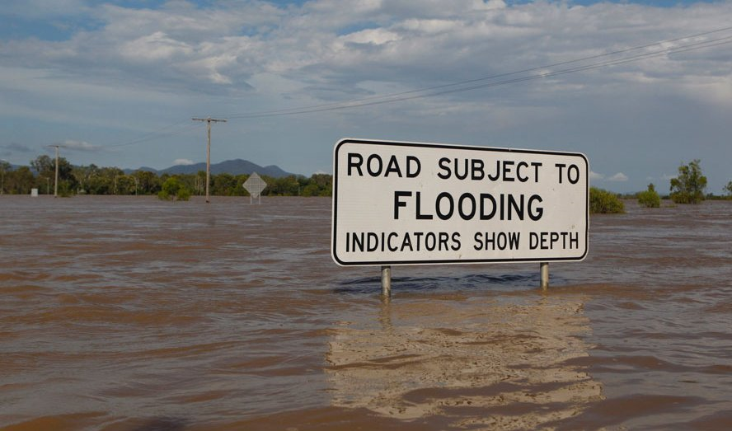
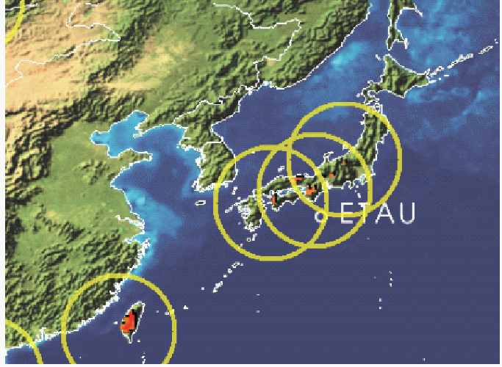
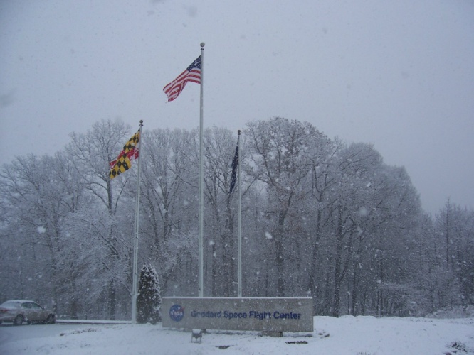
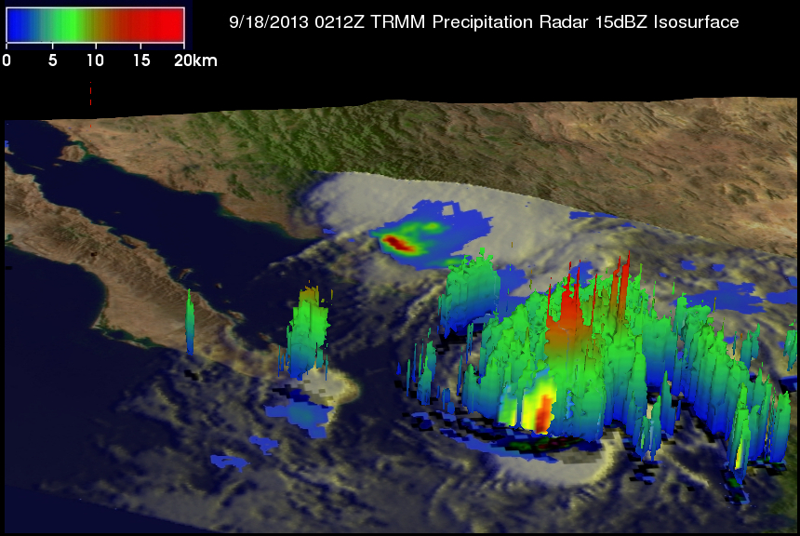
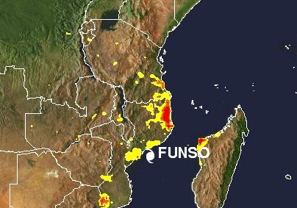
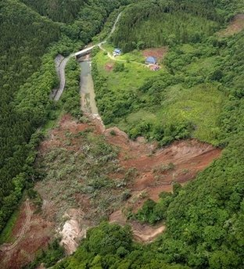
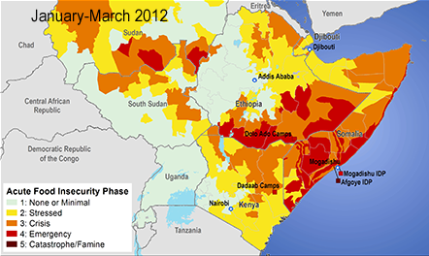
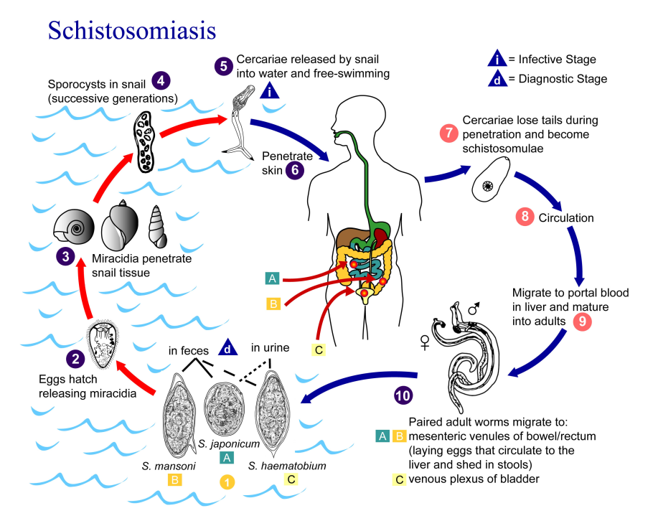
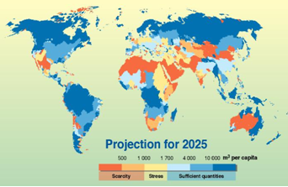
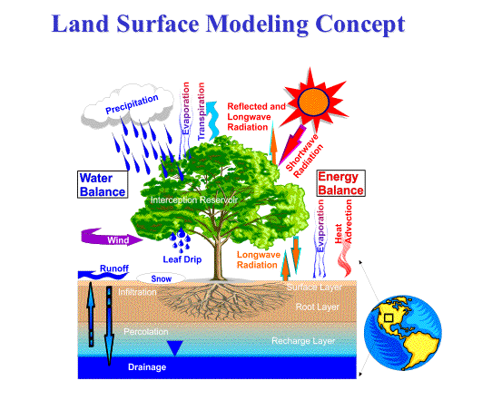
GPM Societal Applications
GPM is an international mission that will provide improved satellite observations of rain and snow worldwide every three hours
The precipitation data from the upcoming GPM mission will extend our capabilities (from TRMM’s) to study a wide range of applications for scientific research and societal benefit.
Flooding
Landslides
Extreme Events
Cyclones
Agriculture/Famine
World Health
Freshwater Availability
Modeling

Slide 6
Societal Benefit Areas
Extreme Events and Disasters
Landslides (NASA Hazard Mapping)
Water Resources and Agriculture
Famine Early Warning System (USGS-USDA-FEMA)
Drought Monitoring (US Drought Monitor-U of Nebraska-Lincoln-NOAA-USDA, NOAA CPC, NCEP)
NWP, Climate & Land Surface Modeling
Numerical Weather Prediction (ECMWF, National Weather Service, The Weather Company)
Land Data Assimilation System Modeling (NASA Land Information System, AFWA, USDA, International Center for Biosaline Agriculture-ICBA, Universities)
Public Health and Ecology
Disease tracking (National Center for Atmospheric Research-NCAR, Universities)
Water resource management (USGS, USDA, NOAA)
Global Climate Modeling and Assimilation (NASA-GMAO, NOAA)
Agricultural monitoring (Agricultural Meteorological Modeling System, USDA, AFWA)
Food Security (USDA, FAO, World Bank, International Red Cross)
Animal migration (Universities, MoveBank.Org)
Re-insurance (Swiss Re)
Multi-hazard situational awareness (Pacific Disaster Center, International Red Cross, World Bank)
Tropical cyclones (Joint Typhoon Warning Center, National Hurricane Center-NOAA, U.S. Military, Air Force Weather Agency-AFWA)
Floods (Global Flood Monitoring System-UMD, International Flood Network-IFNet)

Slide 7
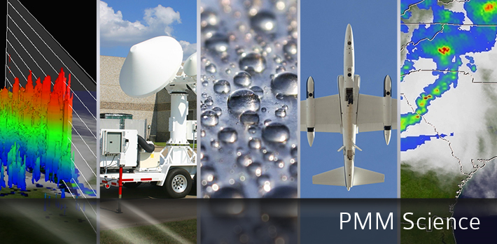
Information on the TRMM and GPM Missions:
http://gpm.nasa.gov
www.nasa.gov/gpm
Twitter: NASA_Rain Facebook: NASA.Rain

Slide 8

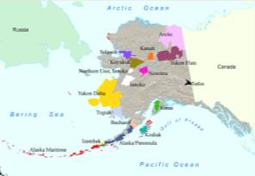
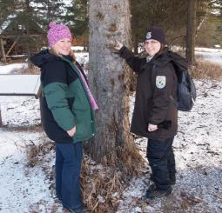
Changing Landscapes of the Kenai NW Refuge
A GPM-Earth to Sky Collaborative Effort
Status (3/24/14): In progress with expected date of completion: Winter 2014
Product: interpretive program
Audience: Families, general public visiting Refuge
Thematic Statement: Climate changes are visible on the Kenai Peninsula in southcentral Alaska. Citizen science observations of weather, seasonal change will contribute to hands-on exploration of weather and climate by visitors to the Kenai National Wildlife Refuge.
Measurable Objectives: 100 visitors will participate in weather monitoring interpretive programs in 2015.
Technique: citizen science investigation
Brief Description: Newly installed weather station at the Refuge Visitor Center supports citizen science investigations into weather and climate. Guided walks will incorporate these observations to further explain climatic change and impacts to the ecosystem.
Timeline to Complete: Delays in new Visitor Center construction have pushed the completion date to this winter, but the weather station is installed and data collection software/process is being piloted this summer.
NASA Resources Used: www.gpm.nasa.gov, climate.nasa.gov
Kenai NWR, in southcentral Alaska is 2 million acres of diverse habitats supporting over 1000 species of flora and fauna.

Slide 9
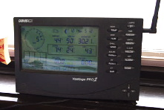
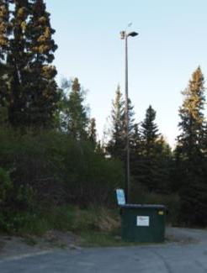
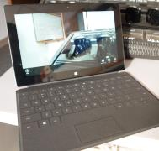
Changing Landscapes of the Kenai NW Refuge
A GPM-Earth to Sky Collaborative Effort
Measurable Objective(s): in progress
Evidence of Achieving Objectives: data expected by summer 2015 after Visitor Center is opened to the public
Evidence of Impact on Audience: though not complete, the addition of weather data collection in a pilot this winter was received positively. Use of technology engaged upper-Elementary and Middle School aged participants and they were actively interested in the process.
Unintended impacts: The weather station has been incorporated into the permanent exhibit at the new Visitor Center, with climate change added as a major interpretive topic in the space .
Anecdotes (stories) about impact on individuals: none yet
Spinoffs, partnerships, other impacts: none yet

Slide 10

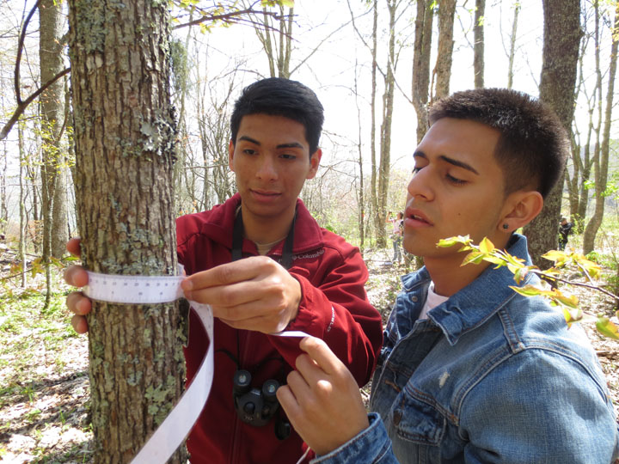
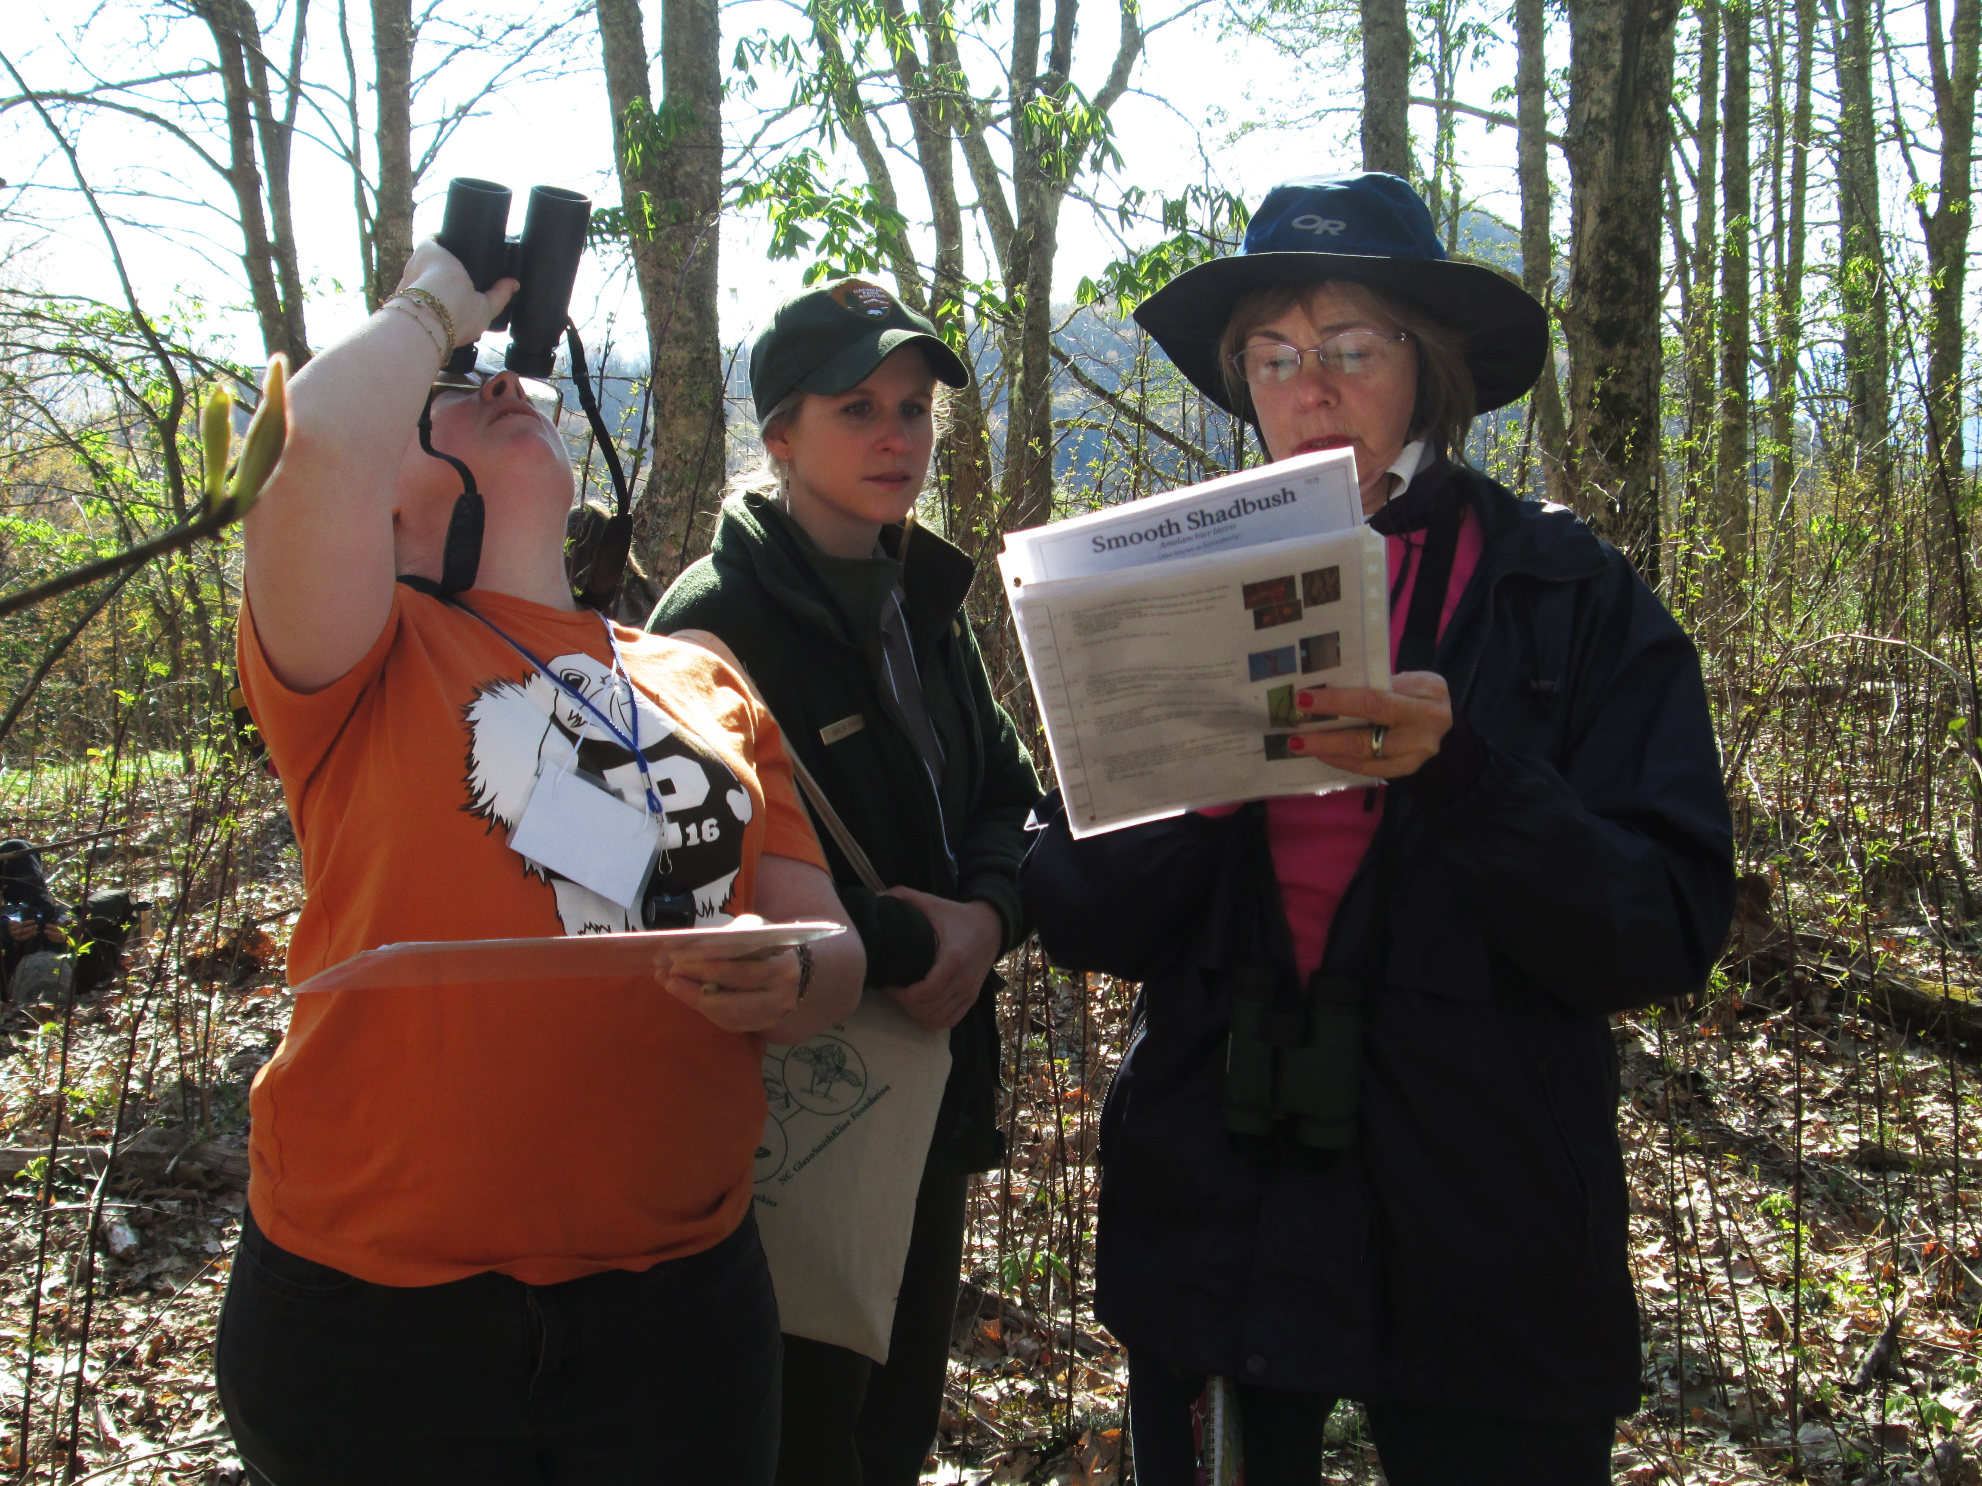
Expansion of “Adopt-a-Phenology Plot” project in Great Smoky Mountains National Park
A GPM-Earth to Sky Collaborative Effort
Status (3/24/14): complete but the project is on-going since it is long-term monitoring
Product: support materials for an on-going citizen science project involving students and community volunteers
Audience: middle & high school students, adults
Thematic Statement: Monitoring phenology is a way to notice subtle changes in our ecosystem due to climate change.
Measurable Objectives: 2,000 students, teachers and volunteers will participate in phenology monitoring in the Smokies in 2013.
Technique: citizen science monitoring of tree phenology, weather measurements in plots & fog monitors
Brief Description: GRSM will expand its phenology monitoring sites in the park used in curriculum based education and “Adopt-a-Phenology Plot” programs. This will include support materials for the new plots and weather monitoring equipment.
Timeline to Complete: Project was completed during the summer of 2013 – materials purchased, 6 new sites set up and equipment distributed to volunteers.
NASA Resources Used: Climate change website, scientist expertise, Earth to Sky website, Landsat images
Two students collect tree circumference data while monitoring trees during a field trip.
Two volunteers learn how to monitor tree phenology

Slide 11
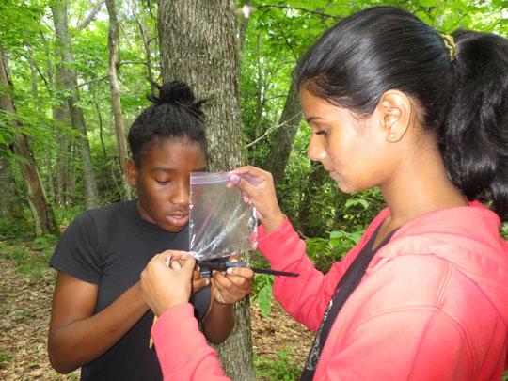
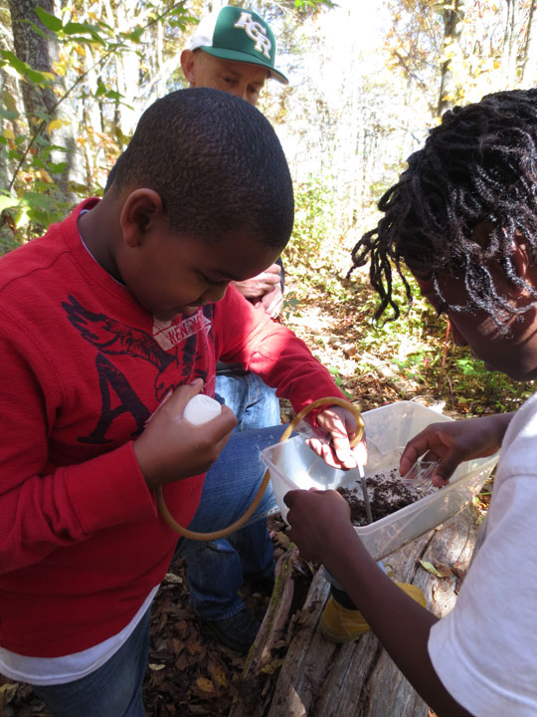
Expansion of “Adopt-a-Phenology Plot” project in Great Smoky Mountains National Park.
A GPM-Earth to Sky Collaborative Effort
Measurable Objective(s) We had 3,000 students participate in phenology monitoring programs in 2013 and have 86 volunteers who have adopted phenology plots to monitor.
Evidence of Achieving Objectives: Statistics for our school programs and volunteer training workshops.
Evidence of Impact on Audience: We evaluate each education program for its impacts on students via a teacher questionnaire. We consistently receive high ratings for our phenology programs which include trees, salamanders and terrestrial invertebrates.
Unintended impacts: The phenology monitoring project for students and community volunteers has been very popular with other educators who are struggling to connect people directly with climate change in areas where impacts are subtle. We have been interviewed by several national news outlets and have been part of two NPS videos on how to connect the public with the issue of climate change.
Anecdotes (stories) about impact on individuals: We see a light bulb go off for many people (both young and old) when they understand that earlier springs mean more than just flowers blooming but it impacts the entire ecosystem. This may mean that some species lose their synchronicity with one another and that can create layers of impacts.
Spinoffs, partnerships, other impacts: This project is still growing. This summer we are starting a spin-off project with Montreat College to offer 6 one-week phenology monitoring science camps in the park for high school students. Monitoring will occur along the Appalachian Trail in the Smokies and is part of the National Phenology Networks AT Seasons monitoring study.
Two girls measure a salamander during a phenology field trip.
Students collect terrestrial invertebrates as part of a phenology monitoring field trip.

Slide 12
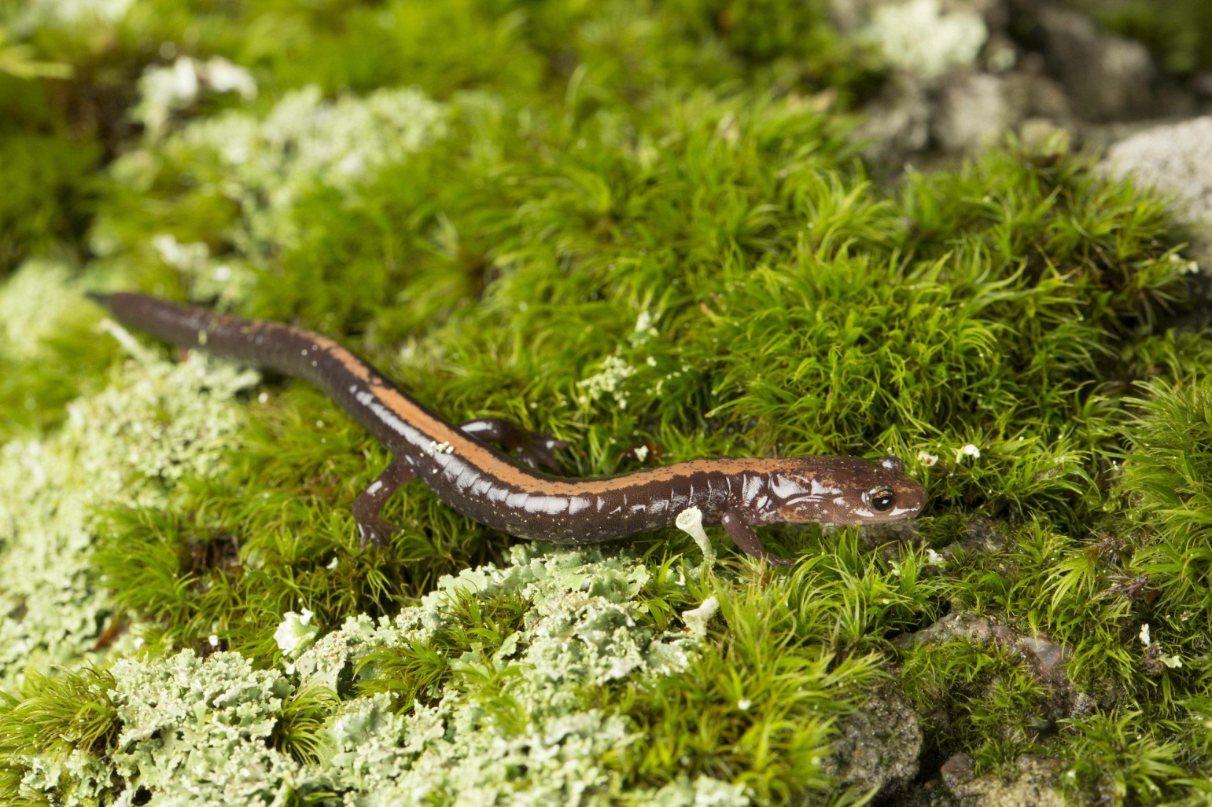
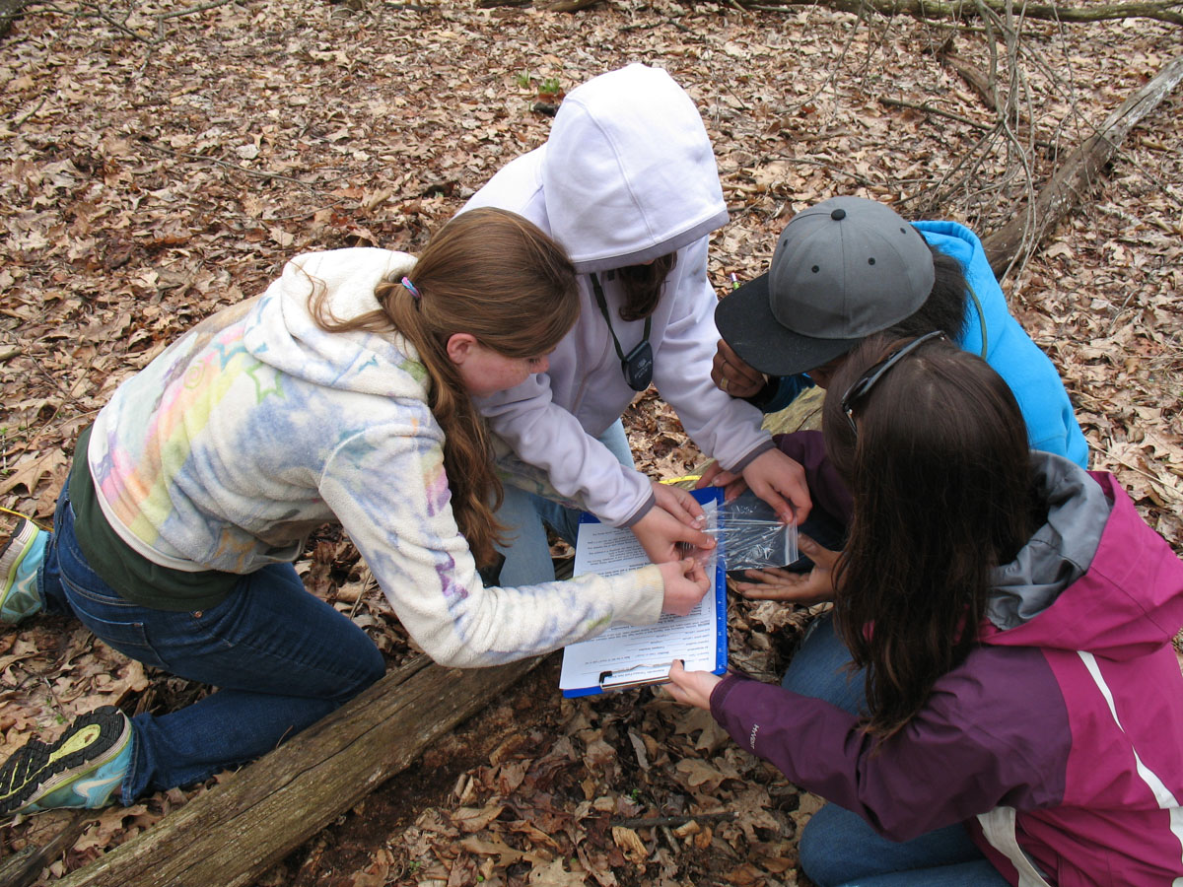
Shenandoah Salamander: Climate Change Casualty or Survivor?
A GPM-Earth to Sky Collaborative Effort
Status (4/10/14): Completed
Product: Ranger-led resource education program
Audience: Middle school to college level science students
Thematic Statement: Climate change and species competition are serious threats to the endangered Shenandoah salamander.
Measurable Objectives: Students will be able to predict the potential impact of climate change and species competition on the survival of the Shenandoah and red-backed salamanders and determine ways people can reduce contributions to climate change.
Technique: Ranger-led program with inquiry-based activities
Brief Description: Students conduct field research on the red-backed salamander to determine if climate change and competition for habitat are impacting the survival of the Shenandoah and red-backed salamanders.
  http://www.nps.gov/shen/forteachers/classrooms/shenandoah-salamander-and-climate-change.htm
Timeline to Complete: Project began June 2012. Program was field tested with students in spring 2013. Implemented in fall 2013.
NASA Resources Used:
  http://climate.nasa.gov/
  http://pmm.nasa.gov/science/climate-change
  http://climatekids.nasa.gov/

Slide 13
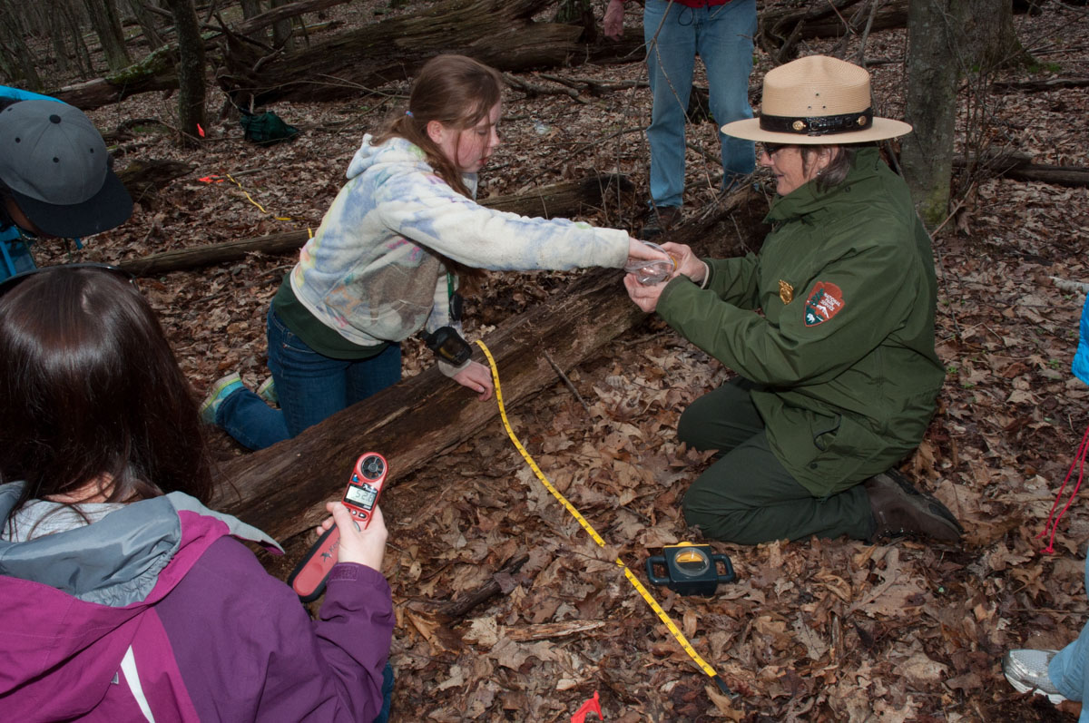
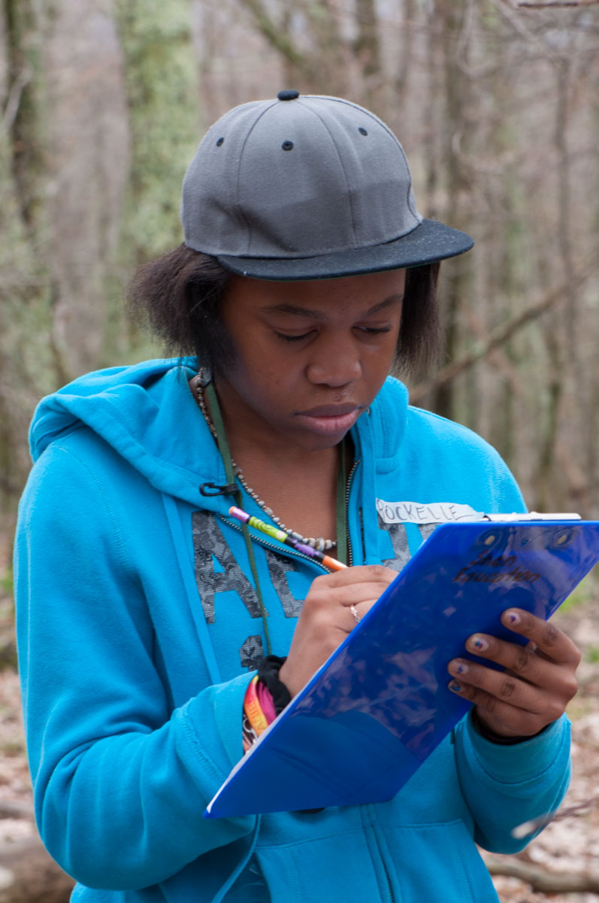
Shenandoah Salamander: Climate Change Casualty or Survivor?
A GPM-Earth to Sky Collaborative Effort
Measurable Objective(s): 120 students participated in the program in the first year.
Evidence of Achieving Objectives: Teacher Feedback:
  “The program aligned with all science levels (6th-10th) as it relates to the environment and collective action for caring for natural resources.”
Evidence of Impact on Audience: Teacher Feedback:
  “Upon arrival back at school the students were buzzing about how cool [the program] was and what it might be like to become a ranger someday.”
Unintended impacts: The original intended audience was middle and high school environmental science students. We discovered the program was also effective for students with learning disabilities and college level students.
Anecdotes (stories) about impact on individuals: In the concluding discussions at the end of the programs, students analyzed their personal choices of energy use and then recognized that they could help reduce climate change by changing individual behaviors.
Spinoffs, partnerships, other impacts: Presented sessions at Virginia Environmental Education Conferences. The Shenandoah National Park Trust funded the creation of a companion climate change/salamander classroom outreach program for 4th grade.

Slide 15
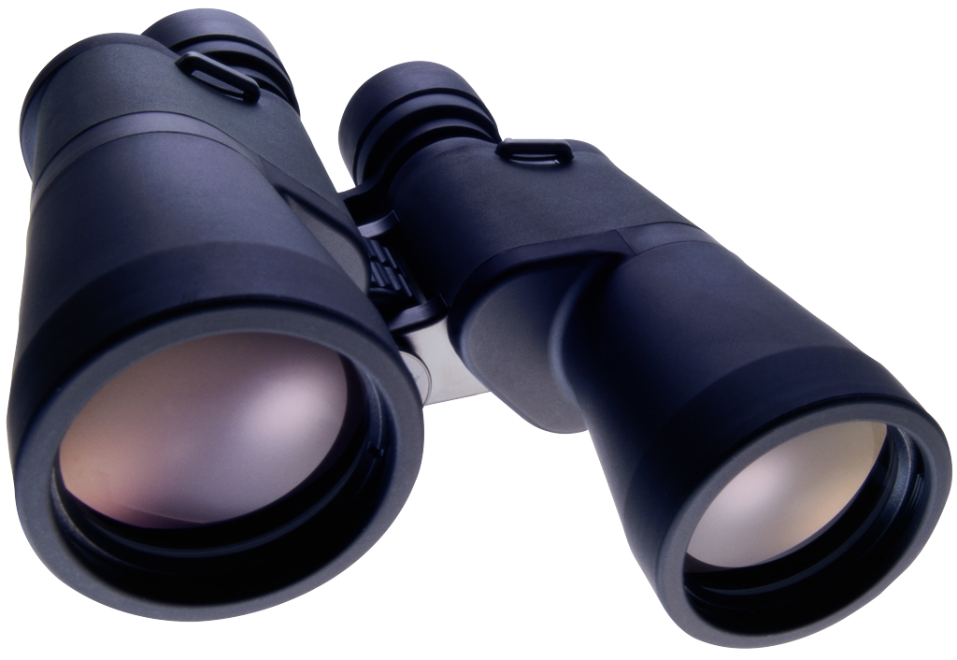
Looking for a new cohort of ETS-GPM Interpreters!
Apply to GPM for one of the mini-grants (up to $2,500) to develop and implement a project that is related to one or more of GPM’s key science themes: Water Cycle, Weather and Climate, Technology and Instrumentation, and Societal Applications.
Application form posted at www.earthtosky.gov and athttp://pmm.nasa.gov/education/earthtosky
E-mail your application to dorian.w.janney@nasa.gov
All applications must be received by COB on June 13th, 2014. We will use a competitive process to select the mini-grant awardees, and will notify you either way by July 5, 2014.
Questions: dorian.w.janney@nasa.gov

