Slide 1
Effective Training: Useful Methodology from the
Earth to Sky Partnership
WELCOME!
National Interpreters Workshop Denver, CO
November 2014
Anita Davis anita.l.davis@nasa.gov 301-614-6669
Ruth Paglierani ruthp@ssl.berkeley.edu 510-643-5669

Slide 3

What is “Earth to Sky?”
Unique Inter-Agency Partnership
Professional Development for Informal and Environmental Educators
Community of Practice
http://www.earthtosky.org

Slide 4




Earth to Sky Partners
ETS began in 2004 with NPS and NASA; USFWS joined in 2008 NOAA in 2013
Notes:
At present this is the partnership

Slide 5
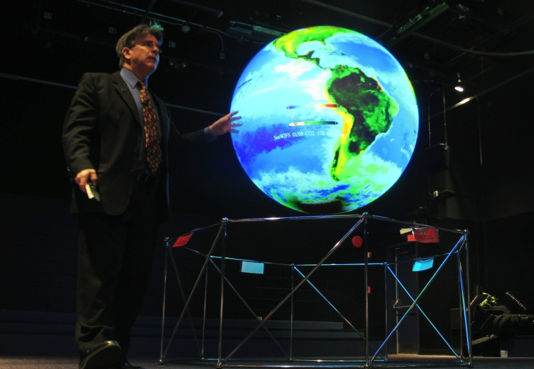
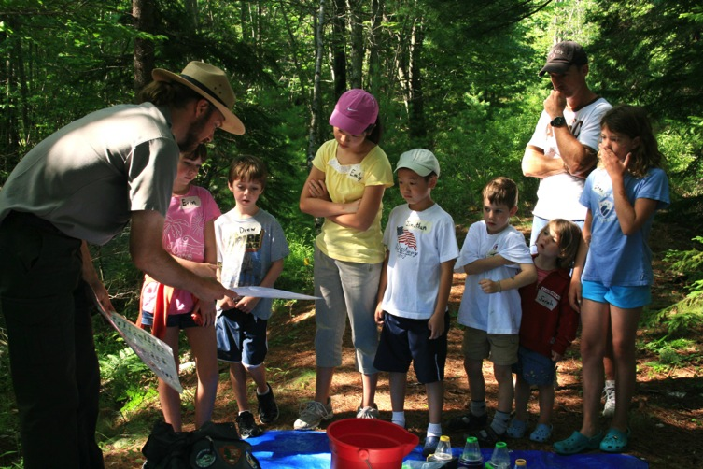
Connecting the Wonders of Science
with the Power of Place
The connection between NASA’s big picture, global perspective and place-based experiences provides powerful opportunities for meaningful learning.

Slide 6
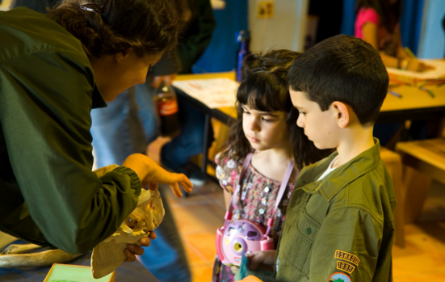
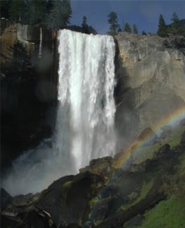
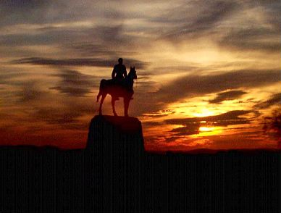
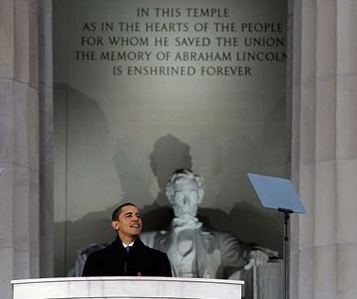
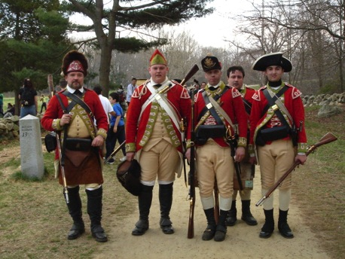
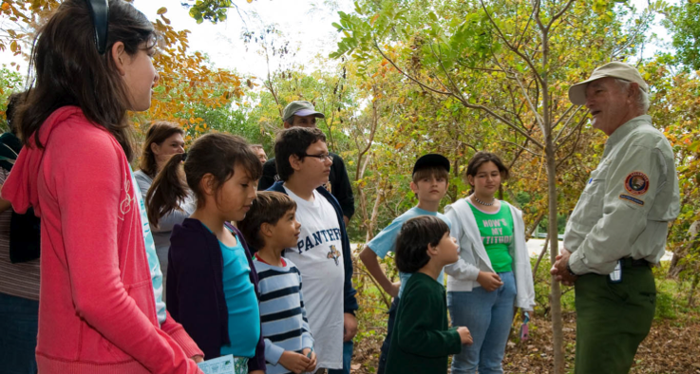
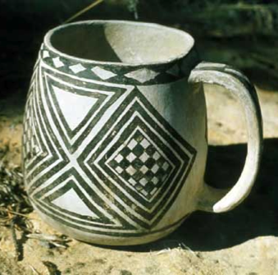
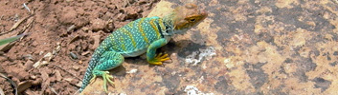

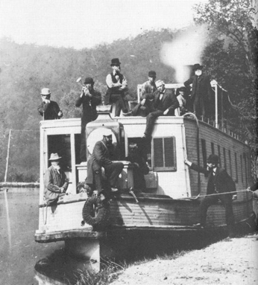
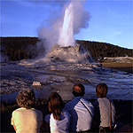
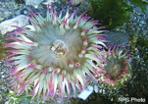
ETS is the Only Interagency Partnership addressing Informal Educators and Climate Change
USFWS and NPS place
330 MILLION visits per year
Access to and expertise with diverse audiences
Powerful linkage to meaningful stories; tangible connections to human experiences
Expert, effective educators (interpretation methodology)
Very high approval rating (96% of visitors)
Staff time and training center resources
NASA | NOAA science
Global view that helps provide context for site-specific information
Concrete, highly respected, relevant science
Incredible visual resources; Office of Communications products
Wide array of educational products and programs
Scientists, education and communication staff
Staff position at NASA
Notes:
(NFL = 17,469,552; Baseball = 73,402,524; NBA = 21,549,238; NHL = 21,475,223 = 133,896,537)

Slide 7
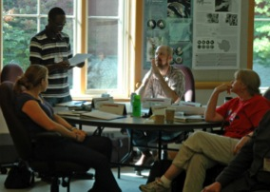

Conduct Professional Development Nurture a Community of Practice
Purpose
Primary Audience:
Train educators
Foster collaborative work (scientists & educators)
Enrich the experiences of visitors
Informal/Environmental Educators
Education/Outreach Specialists
Public Affairs Specialists
Activities:
Five Day Face-to-Face Course
Regionally focused blended learning
E-Course
Webinars
Conference Presentations and Workshops
Website http://www.earthtosky.org
Listserv (500 members)
Facebook Group
https://www.facebook.com/groups/274560916051139/

Slide 8
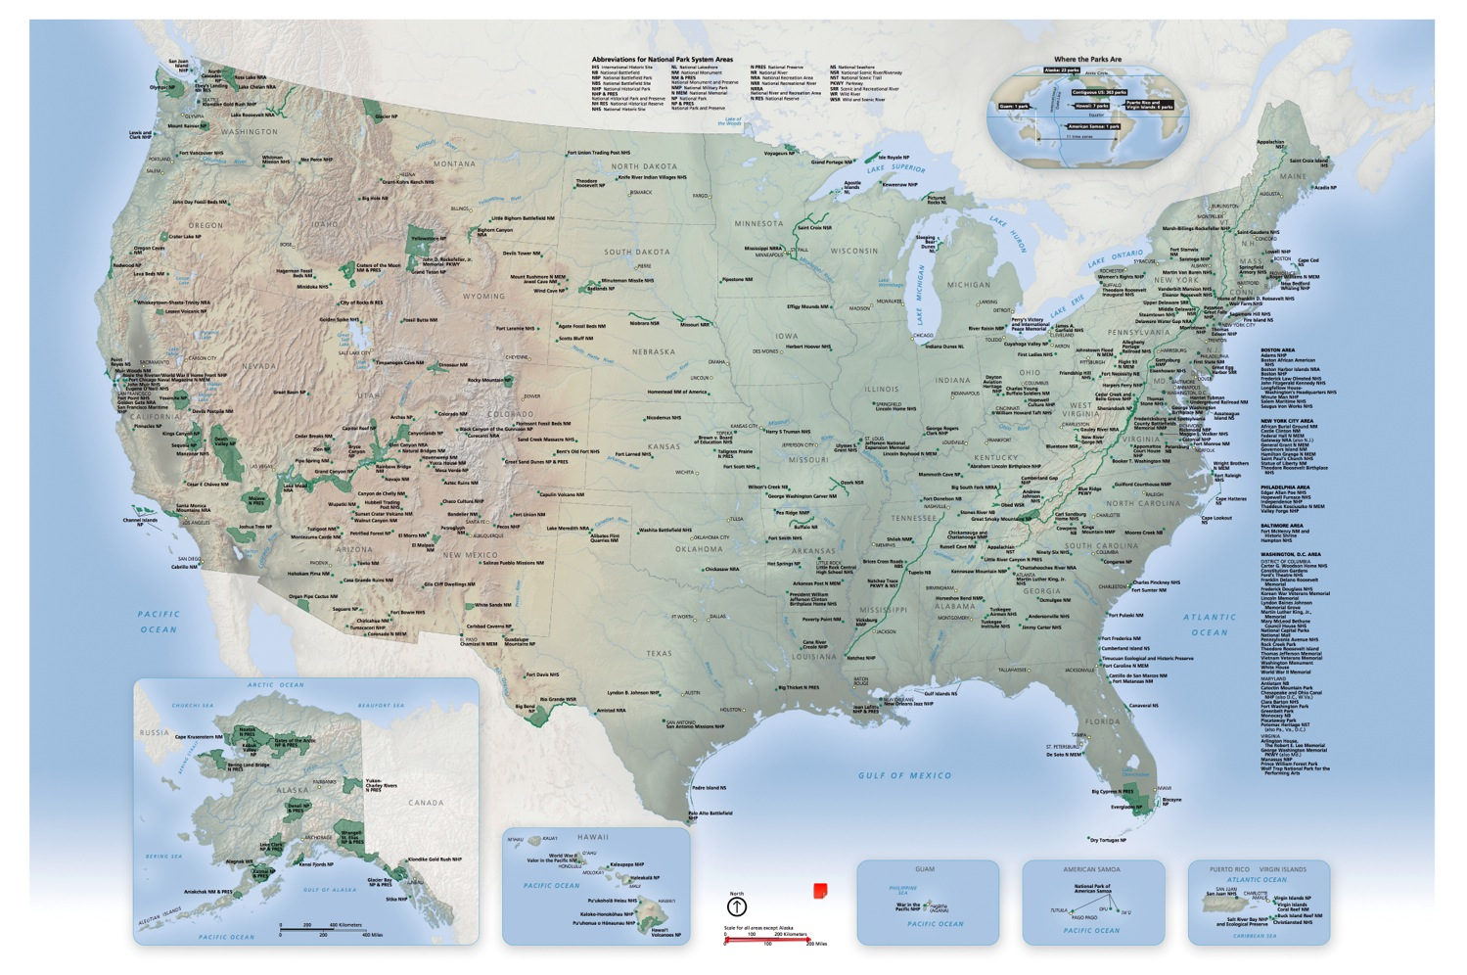
700+ Educators Trained at Sites Across the U.S.
Notes:
Location of Participants ETS I through ETS VI; note the base map is of NPS sites, so USFWS sites are not identified.

Slide 9
Session Agenda
Ice Breaker
Experience in the Room
Results from Successful Training
Your Task!
Using Best Practices from ETS
Reflection Time
The Authentic Task Illustrated
Feedback

Slide 10

Ice Breaker
Where are you from? (or where do you work?)
What was your favorite training ever, and the main reason why
Who is the audience for the training you expect to give within the next year?

Slide 11
Session Agenda
Ice Breaker
Experience in the Room
Results from Successful Training
Your task!
Using Best Practices from ETS
Reflection Time
The Authentic Task Illustrated
Feedback

Slide 12
Session Agenda
Ice Breaker
Experience in the Room
Results from Successful Training
Your Task!
Using Best Practices from ETS
Reflection Time
The Authentic Task Illustrated
Feedback

Slide 13
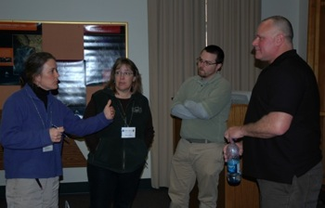
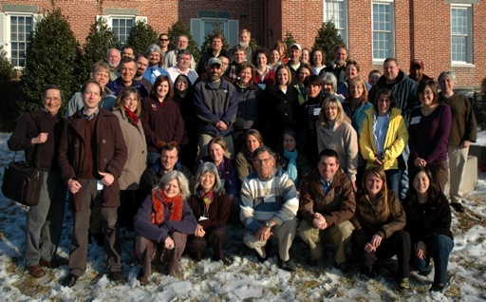
Evaluation Metrics
Over 4 million visitors to National Parks and Wildlife Refuges Reached
2004-2013 Earth to Sky
Conducted 6 week-long courses
Hosted 75 NASA scientist presenters
Presented 100 NASA science sessions
Trained Educators:
  135 participants in week-long face to face courses
  35 participants in one and two day workshops at professional conferences
  Over 535 educators via distance learning and sessions at conferences, in a variety of subjects, including climate science, and best practices in science communication
Shared the ETS training model internally and externally so others can replicate similar efforts.
Notes:
The 4 million figure comes from evaluation work that followed 86 alumni of the week long face-to-face courses. Over the course of 3 years we tracked their efforts. This is a gross underestimate, as we know that many efforts were not quantified (eg., NPS did not track the number of podcasts that were accessed; some of these projects and programs are continuing today as well, but we have not been able to continue to track all of the alumni work.)

Slide 14
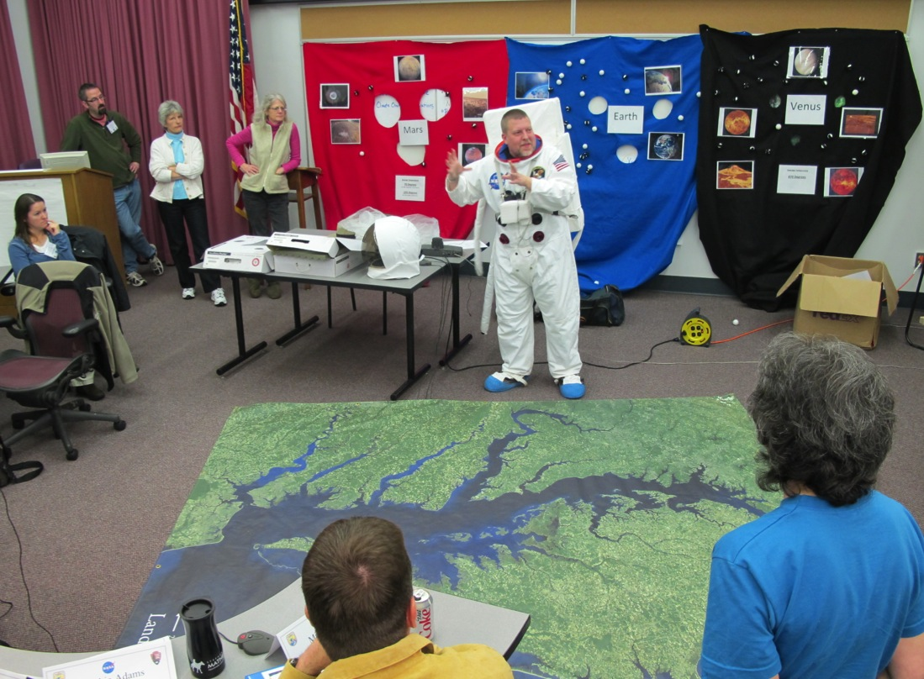
Alumni become Trainers
Jr. Ranger Day Camp at Rock Creek; demonstrated at ETS IV by Ranger Ron Harvey

Slide 15
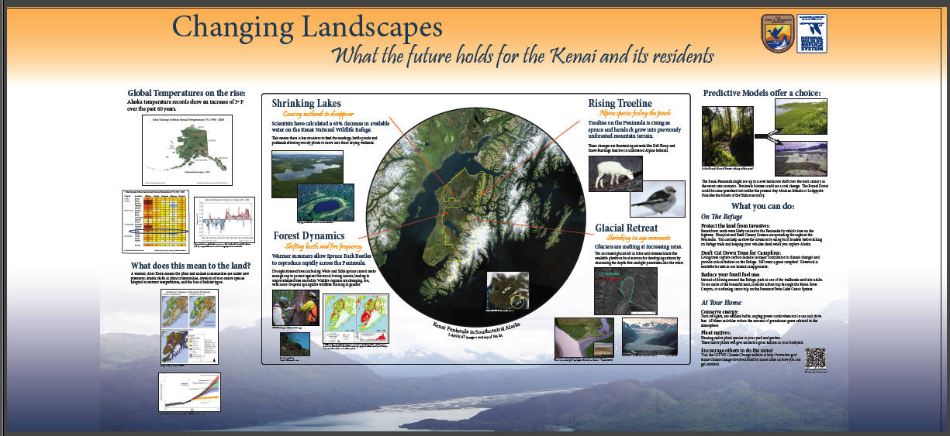
Connecting the Wonders of Science
with the Power of Place
Notes:
How does this translate into real work? Through a myriad of products, programs and activities that alumni accomplish.

Slide 16

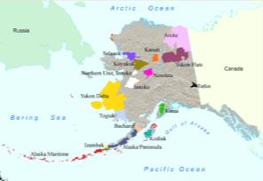
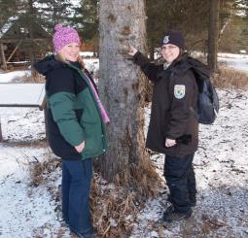
Changing Landscapes of the Kenai NW Refuge
A GPM-Earth to Sky Collaborative Effort
Status (3/24/14): In progress with expected date of completion: Winter 2014
Product: interpretive program
Audience: Families, general public visiting Refuge
Thematic Statement: Climate changes are visible on the Kenai Peninsula in southcentral Alaska. Citizen science observations of weather, seasonal change will contribute to hands-on exploration of weather and climate by visitors to the Kenai National Wildlife Refuge.
Measurable Objectives: 100 visitors will participate in weather monitoring interpretive programs in 2015.
Technique: citizen science investigation
Brief Description: Newly installed weather station at the Refuge Visitor Center supports citizen science investigations into weather and climate. Guided walks will incorporate these observations to further explain climatic change and impacts to the ecosystem.
Timeline to Complete: Delays in new Visitor Center construction have pushed the completion date to this winter, but the weather station is installed and data collection software/process is being piloted this summer.
NASA Resources Used: www.gpm.nasa.gov, climate.nasa.gov
Kenai NWR, in southcentral Alaska is 2 million acres of diverse habitats supporting over 1000 species of flora and fauna.

Slide 17

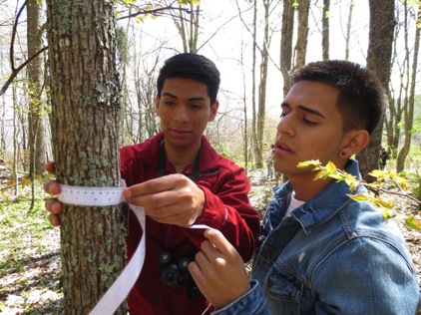
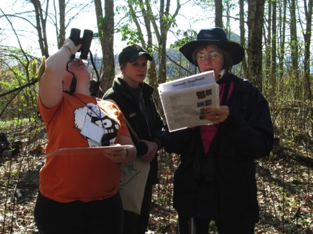
Expansion of “Adopt-a-Phenology Plot” project in Great Smoky Mountains National Park
A GPM-Earth to Sky Collaborative Effort
Status (3/24/14): complete but the project is on-going since it is long-term monitoring
Product: support materials for an on-going citizen science project involving students and community volunteers
Audience: middle & high school students, adults
Thematic Statement: Monitoring phenology is a way to notice subtle changes in our ecosystem due to climate change.
Measurable Objectives: 2,000 students, teachers and volunteers will participate in phenology monitoring in the Smokies in 2013.
Technique: citizen science monitoring of tree phenology, weather measurements in plots & fog monitors
Brief Description: GRSM will expand its phenology monitoring sites in the park used in curriculum based education and “Adopt-a-Phenology Plot” programs. This will include support materials for the new plots and weather monitoring equipment.
Timeline to Complete: Project was completed during the summer of 2013 – materials purchased, 6 new sites set up and equipment distributed to volunteers.
NASA Resources Used: Climate change website, scientist expertise, Earth to Sky website, Landsat images
Two students collect tree circumference data while monitoring trees during a field trip.
Two volunteers learn how to monitor tree phenology

Slide 18
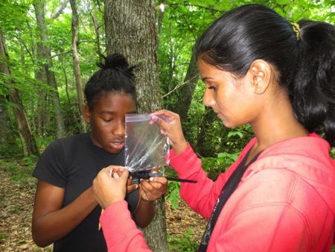
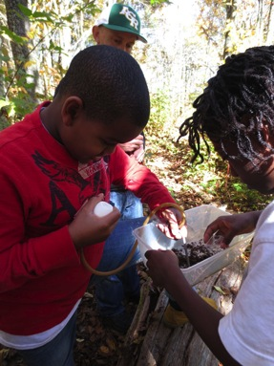
Expansion of “Adopt-a-Phenology Plot” project in Great Smoky Mountains National Park.
A GPM-Earth to Sky Collaborative Effort
Measurable Objective(s) We had 3,000 students participate in phenology monitoring programs in 2013 and have 86 volunteers who have adopted phenology plots to monitor.
Evidence of Achieving Objectives: Statistics for our school programs and volunteer training workshops.
Evidence of Impact on Audience: We evaluate each education program for its impacts on students via a teacher questionnaire. We consistently receive high ratings for our phenology programs which include trees, salamanders and terrestrial invertebrates.
Unintended impacts: The phenology monitoring project for students and community volunteers has been very popular with other educators who are struggling to connect people directly with climate change in areas where impacts are subtle. We have been interviewed by several national news outlets and have been part of two NPS videos on how to connect the public with the issue of climate change.
Anecdotes (stories) about impact on individuals: We see a light bulb go off for many people (both young and old) when they understand that earlier springs mean more than just flowers blooming but it impacts the entire ecosystem. This may mean that some species lose their synchronicity with one another and that can create layers of impacts.
Spinoffs, partnerships, other impacts: This project is still growing. This summer we are starting a spin-off project with Montreat College to offer 6 one-week phenology monitoring science camps in the park for high school students. Monitoring will occur along the Appalachian Trail in the Smokies and is part of the National Phenology Networks AT Seasons monitoring study.
Two girls measure a salamander during a phenology field trip.
Students collect terrestrial invertebrates as part of a phenology monitoring field trip.

Slide 19
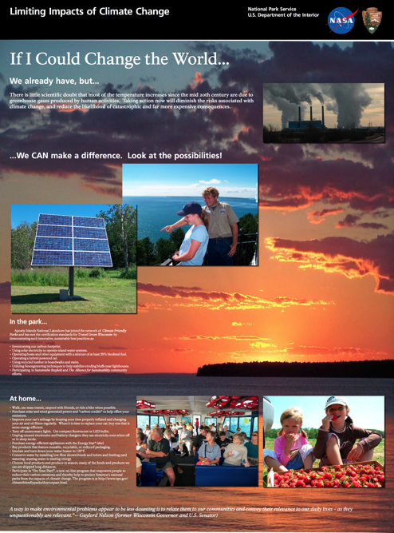
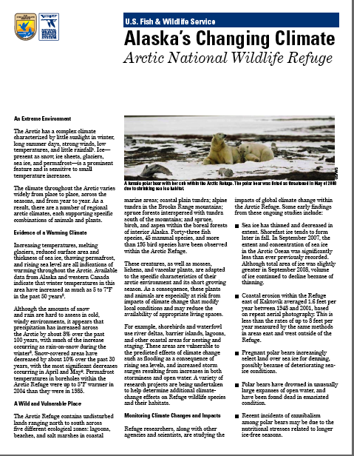
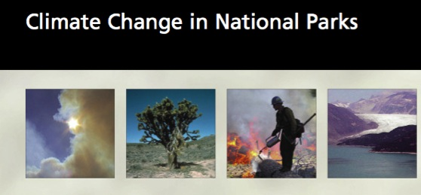
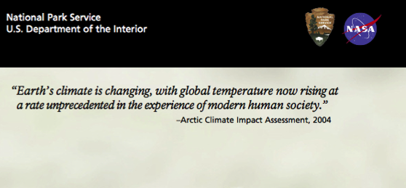
One of four new exhibit panels at Apostle Islands National Lakeshore Visitor Center.
450,000 of these brochures have been distributed in parks around the US.
Flyer on climate change impacts at Arctic National Wildlife Refuge.

Slide 20
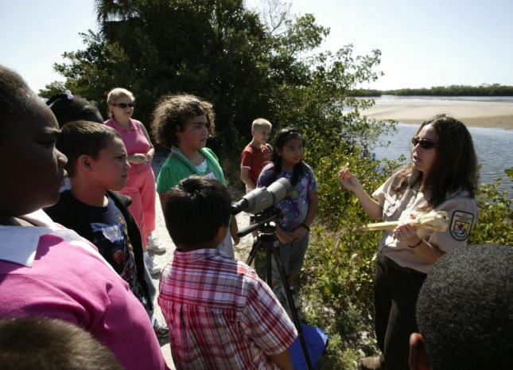
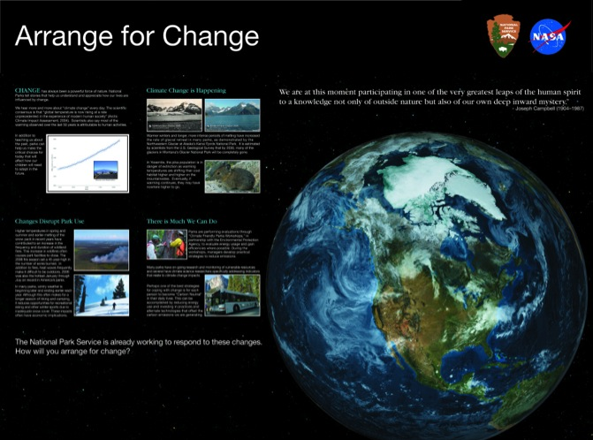
Personal Interpretation explains effects of climate change in Refuges and Parks
Traveling exhibits showcased at National Parks and training venues throughout the US.

Slide 21

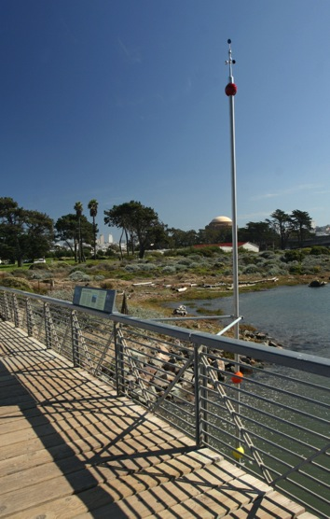

WebRanger Climate Change Activity Investigating Global Connections for grade school level. 4,900 registered WebRangers have completed this activity. Two more under development. www.webrangers.us/activities/climate
Outdoor Exhibit at Crissy Field, Golden Gate NRA - depicts predicted sea level rise, received front page coverage in San Francisco Chronicle. Duplicate exhibits under development.

Slide 22
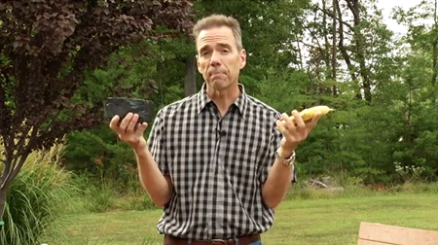
Improving Science Communication
http://www.youtube.com/watch?v=uStoBFtjy8U
2nd version (animated) http://geeked.gsfc.nasa.gov/?cat=170
Dr. Peter Griffith, founding director of NASA’s Carbon Cycle & Ecosystems Office

Slide 23
Session Agenda
Ice Breaker
Experience in the Room
Results from Successful Training
Your Task!
Using Best Practices from ETS
Reflection Time
The Authentic Task Illustrated
Feedback

Slide 24
Session Agenda
Ice Breaker
Experience in the Room
Results from Successful Training
Your Task!
Using Best Practices from ETS
Reflection Time
The Authentic Task Illustrated
Feedback

Slide 25

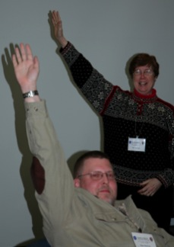
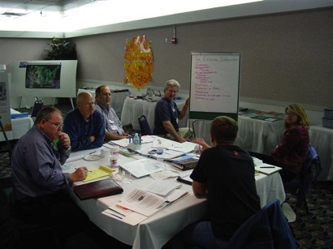
Use Best Practices for Professional Development
Establish & share clear expectations
Design activities to engage all participants
Model effective learning processes
Establish clear roles
Have participants take responsibility
Connect with participant’s own work
Provide time to do “authentic” work
Encourage participants to share
Provide ample time for reflection
Provide guidance and support
Provide opportunities for continued learning
Incorporate evaluation throughout
Notes:
All training is developed to support the learner and is based on a set of 12 Best Practices
We are engaging participants in authentic work, and we want them to be successful in implementing their action plans
To help achieve this,
ETS Alumni act as coaches for small groups of participants and also work with the science presenters to ensure appropriate content.
When working on their action plans, participants have the support of their coaches who provide guidance and support
After the course, we provide opportunities for continued learning through webinars, the ETS website and the CoP

Slide 26
Session Agenda
Ice Breaker
Experience in the Room
Results from Successful Training
Your Task!
Using Best Practices from ETS
Reflection Time
The Authentic Task Illustrated
Feedback

Slide 27
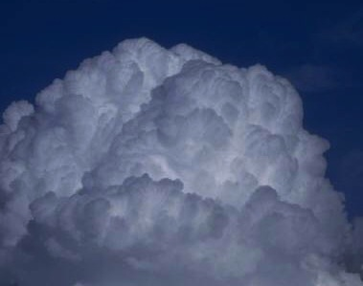
Time to Think!
What did I just see?
What did I learn?
…What am I thinking?
Notes:
Process questions. 3-5 minutes use journals to write quick answers to these
What did I just see?
What did I learn?
What am I thinking?

Slide 28
Session Agenda
Ice Breaker
Experience in the Room
Results from Successful Training
Your Task!
Using Best Practices from ETS
Reflection Time
The Authentic Task Illustrated
Feedback

Slide 29
Elements of the Authentic Task Approach
Clarify Your Task
Identify Criteria for Success
Use data to make decisions and track your work
Identify Relevant Resources
Scheduling Activities
Take Time to Reflect
Develop an Implementation Plan
key features:
guided facilitation
protected time
a resource rich environment
continuous reflection

Slide 30
Session Agenda
Ice Breaker
Experience in the Room
Results from Successful Training
Your Task!
Using Best Practices from ETS
Reflection Time
The Authentic Task Illustrated
Feedback

Slide 32
Many Thanks!
Anita Davis anita.l.davis@nasa.gov 301-614-6669
Ruth Paglierani ruthp@ssl.berkeley.edu 510-643-5669

Slide 33
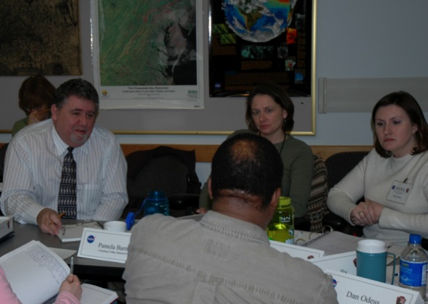
Course Structure Builds Expertise and Community
Leaders
course coordinators
develop courses
select coaches and participants
pair coaches with presenters
Participants
learn from presenters,
coaches and each other
provide feedback
participate in
longitudinal evaluation
Coaches
alumni with leadership qualities
coach presenters
mentor participants
advise course coordinators
(before, during and after course)
Presenters
learn better
communication technique
from coaches
provide expertise to
participants during and
after the course
a few have partnered with
course alumni

Slide 34
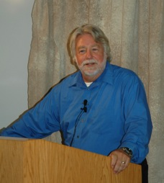
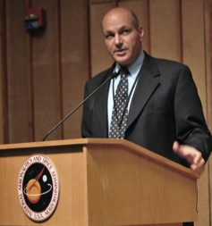
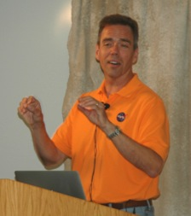
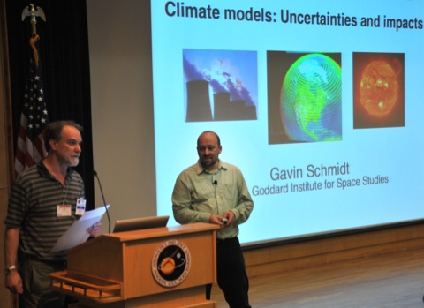
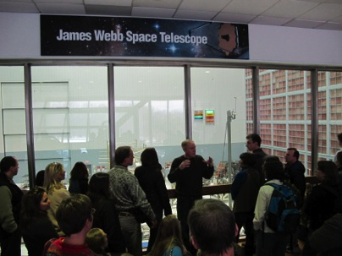
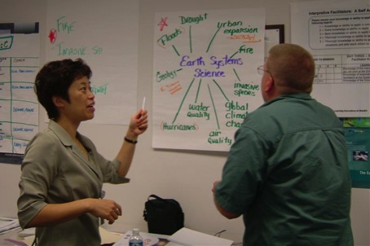
Face-to-Face Course Structure
NASA Scientists provide science content
Alumni Informal/Environmental Educators coach science presenters and participants
NASA Education and Outreach staff provide NASA education and communication materials
Visit to NASA Goddard Space Flight Center (MD)

